Slide 1
INTRODUCTION TO WEB DEVELOPMENT (HTML)

Slide 2
INTRODUCTION

Slide 3
What is HTML?
HTML stands for Hyper Text Markup Language
HTML is the standard markup language for creating Web pages
HTML describes the structure of a Web page
HTML consists of a series of elements
HTML elements tell the browser how to display the content

Slide 4




Web Browsers
The purpose of a web browser (Chrome, Edge, Firefox, Safari) is to read HTML documents and display them correctly.
A browser does not display the HTML tags, but uses them to determine how to display the document
Google Chrome
Mozilla Firefox
Safari
Microsoft Edge

Slide 5




HTML Editors
HTML Editors are tools to write and run (in some cases) an HTML code. There are several HTML Editors available to the user

Slide 6
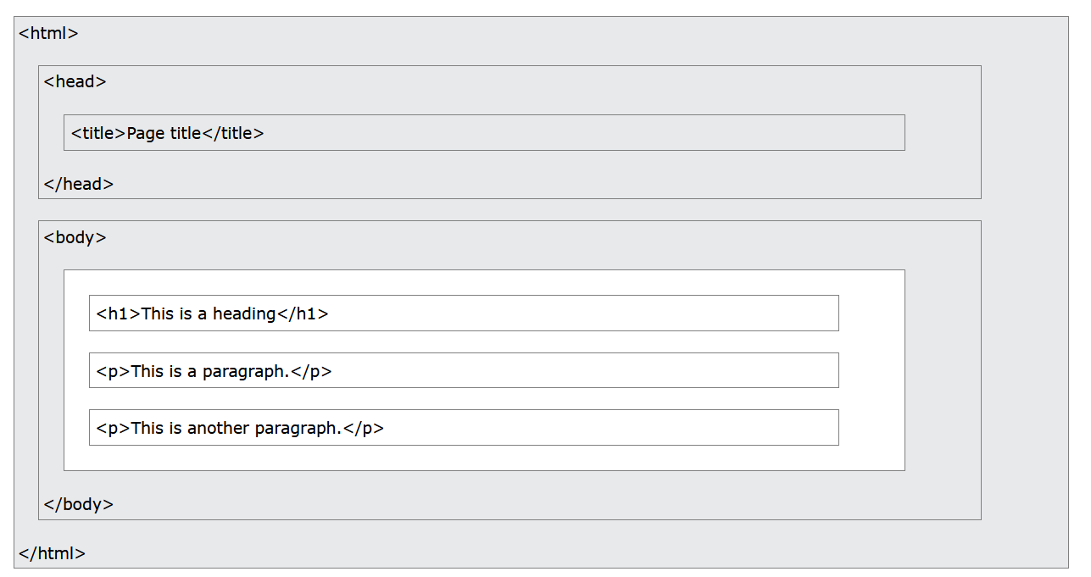
HTML Page Structure

Slide 7
HTML BASICS

Slide 8
Basic Structure of an HTML Document
Every HTML document starts with a doctype declaration (<!DOCTYPE html>).
HTML documents have a structure with <html>, <head>, and <body> tags.
<html>: The root element of an HTML page.
<head>: Contains meta-information about the document (e.g., title, meta tags, links to stylesheets).
<body>: Contains the content of the HTML document.

Slide 9
<!DOCTYPE html>
<html>
<head>
<title></title>
</head>
<body>
</body>
</html>

Slide 10
Headings and Paragraphs
Headings range from <h1> to <h6>, with <h1> being the highest level and <h6> the lowest.
Headings are used to define important sections and provide a hierarchical structure to the document.
Paragraphs are defined with the <p> tag and are used to group sentences and sections of text.
<h1>Main Heading</h1>
<h2>Subheading</h2>
<p>This is a paragraph of text. Paragraphs make the text more readable by breaking it into sections.</p>
<h3>Another Subheading</h3>
<p>Another paragraph with additional information.</p>
Practice:
Create a document with different levels of headings.
Add multiple paragraphs of text below each heading.

Slide 11
Text Formatting Tags
<b> and <strong> tags are used for bold text.
The <strong> tag also indicates that the text is of strong importance.
<i> and <em> tags are used for italic text.
The <em> tag also indicates that the text is emphasized.
<u> tag is used for underlined text.
<br> tag is used for line breaks.
<hr> tag is used to create horizontal rules (lines) that visually separate sections of content.

Slide 12
Text Formatting Tags
<p>This is <b>bold</b> text.</p>
<p>This is <strong>strong</strong> text.</p>
<p>This is <i>italic</i> text.</p>
<p>This is <em>emphasized</em> text.</p>
<p>This is <u>underlined</u> text.</p>
<p>This is the first line.<br>This is the second line.</p>
<p>This is some text.<hr>This is a new section separated by a horizontal rule.</p>

Slide 13
Links and Images
Links are defined with the <a> tag.
The href attribute specifies the URL of the page the link goes to.
Links can open in the same tab or a new tab using the target attribute.
Images are defined with the <img> tag.
The src attribute specifies the path to the image.
The alt attribute provides alternative text for the image.
Images can be resized using the width and height attributes.
<a href="https://www.example.com">This is a link</a>
<a href="https://www.example.com" target="_blank">This link opens in a new tab</a>
<img src="image.jpg" alt="Description of image" width="500" height="600">

Slide 14
Links and Images
Links are defined with the <a> tag.
The href attribute specifies the URL of the page the link goes to.
Links can open in the same tab or a new tab using the target attribute.
Images are defined with the <img> tag.
The src attribute specifies the path to the image.
The alt attribute provides alternative text for the image.
Images can be resized using the width and height attributes.
<a href="https://www.example.com">This is a link</a>
<a href="https://www.example.com" target="_blank">This link opens in a new tab</a>
<img src="image.jpg" alt="Description of image" width="500" height="600">

Slide 15
Unordered Lists
Unordered lists are used to group a set of items in no particular order.
They are defined using the <ul> tag.
Each item in the list is defined using the <li> (list item) tag.
<h2>Shopping List</h2>
<ul>
<li>Milk</li>
<li>Bread</li>
<li>Eggs</li>
<li>Butter</li>
</ul>
<h2>Favorite Fruits</h2>
<ul>
<li>Apples</li>
<li>Bananas</li>
<li>Cherries</li>
<li>Grapes</li>
</ul>
<h2>Nested Unordered List</h2>
<ul>
<li>Fruits
<ul>
<li>Apples</li>
<li>Bananas</li>
</ul>
</li>
<li>Vegetables
<ul>
<li>Carrots</li>
<li>Spinach</li>
</ul>
</li>
</ul>

Slide 16
Ordered Lists
Ordered lists are used to group a set of items in a specific order.
They are defined using the <ol> tag.
Each item in the list is defined using the <li> (list item) tag.
By default, the list items are numbered, but you can change the type of numbering using the type attribute.
<h2>Top 5 Favorite Movies</h2>
<ol>
<li>Inception</li>
<li>The Matrix</li>
<li>Interstellar</li>
<li>Fight Club</li>
<li>The Dark Knight</li>
</ol>
<h2>Steps to Make a Sandwich</h2>
<ol>
<li>Get two slices of bread.</li>
<li>Spread butter on each slice.</li>
<li>Add your favorite filling (e.g., ham, cheese, etc.).</li>
<li>Put the slices together.</li>
<li>Cut the sandwich in half if desired.</li>
</ol>

Slide 17
Navigation Menus
Navigation menus are created using a combination of <nav>, <ul>, and <li> tags.
The <nav> tag is used to define a set of navigation links.
<nav>
<ul>
<li><a href=“index.html">Home</a></li>
<li><a href="about,html">About</a></li>
<li><a href="#services">Services</a></li>
<li><a href="#contact">Contact</a></li>
</ul>
</nav>

Slide 18
Basic Table Structure
The <table> tag defines the table.
The <tr> tag defines a table row.
The <td> tag defines a table cell (data).
The <th> tag defines a table header.

Slide 19
Basic Table Structure
<table border="1">
<tr>
<th>Name</th>
<th>Age</th>
<th>City</th>
</tr>
<tr>
<td>John Doe</td>
<td>28</td>
<td>New York</td>
</tr>
<tr>
<td>Jane Smith</td>
<td>32</td>
<td>Los Angeles</td>
</tr>
<tr>
<td>Sam Johnson</td>
<td>24</td>
<td>Chicago</td>
</tr>
</table>

Slide 20
HOME PAGE
Home
News
Blog
About US
Contact Us
Nav Bar
NEWS
News
NEW 1
footer

Slide 21
HOME PAGE
Nav Bar
NEW 1
NEWS
News
NEW 1
NEWS
News
footer

Slide 22
BLOG PAGE
Nav Bar
footer

Slide 23
About PAGE
Nav Bar
image
footer

Slide 24
Contact PAGE
Nav Bar
Contact Us
Name
Email
Message
Submit
footer

Slide 25
Basic Table Structure
<h2>Table with Caption</h2>
<table border="1">
<caption>Employee Information</caption>
<tr>
<th>ID</th>
<th>Name</th>
<th>Department</th>
</tr>
<tr>
<td>101</td>
<td>Alice Brown</td>
<td>HR</td>
</tr>
<tr>
<td>102</td>
<td>Bob White</td>
<td>IT</td>
</tr>
<tr>
<td>103</td>
<td>Charlie Green</td>
<td>Finance</td>
</tr>
</table>

Slide 26
Table Attributes and Styling
border: Sets the width of the table's border.
cellpadding: Sets the space between the cell content and the cell border.
cellspacing: Sets the space between individual table cells.
<table border="1" cellpadding="10" cellspacing="5">

Slide 27
HTML- Forms
The <form> tag is used to create an HTML form for user input.
The action attribute specifies where to send the form data when the form is submitted.
The method attribute specifies how to send the form data (GET or POST).
<h2>Contact Form</h2>
<form action="/submit" method="post">
<!-- Form elements go here -->
<label for="name">Name:</label>
<input type="text" id="name" name="name"><br><br>
<label for="password">Password:</label> <input type="password" id="password" name="password"><br><br>
<label for="email">Email:</label>
<input type="email" id="email" name="email"><br><br>
<label for="message">Message:</label>
<textarea id="message" name="message"></textarea><br><br>
<label for="comments">Comments:</label><br> <textarea id="comments" name="comments" rows="4" cols="50"></textarea><br><br>
<input type="submit" value="Submit">
</form>

Slide 28
Introduction to Semantic Elements
<header>: Defines a header for a document or a section. It often contains introductory content or navigational links.
<nav>: Defines a set of navigation links.
<main>: Specifies the main content of a document.
<section>: Represents a standalone section of content.
<article>: Represents a self-contained piece of content, such as a blog post or news article.
<aside>: Represents content that is tangentially related to the content around it, such as sidebars or call-out boxes.
<footer>: Defines a footer for a document or a section. It often contains information about the author, copyright information, or links to related documents.

Slide 29
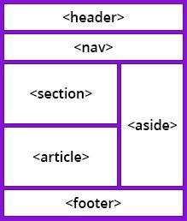
Introduction to Semantic Elements

Slide 30
Introduction to Semantic Elements
<!DOCTYPE html>
<html>
<head>
<title>Semantic Elements Example</title>
</head>
<body>
</body>
</html>

Slide 31
Introduction to Semantic Elements
<header>
<h1>My Website</h1>
<nav>
<ul>
<li><a href="#home">Home</a></li>
<li><a href="#about">About</a></li>
<li><a href="#contact">Contact</a></li>
</ul>
</nav>
</header>
<main>
<section>
<h2>Welcome to My Website</h2>
<p>This is the main content area where you can add sections and articles.</p>
</section>

Slide 32
Introduction to Semantic Elements
<article>
<h3>Latest News</h3>
<p>This is an article about the latest news. Articles can contain text, images, and other content.</p>
</article>
<aside>
<h4>Related Links</h4>
<ul>
<li><a href="#link1">Link 1</a></li>
<li><a href="#link2">Link 2</a></li>
</ul>
</aside>
</main>

Slide 33
Introduction to Semantic Elements
<footer>
<p>&copy; 2024 My Website</p>
</footer>

Slide 34
Project One

Slide 35
Part Two

Slide 36
Introduction to Cascading Style Sheets (CSS)

Slide 37

Introduction to Cascading Style Sheets (CSS)
What is CSS?
CSS (Cascading Style Sheets): A language used to describe the presentation of a web page, including colors, layout, and fonts.
Purpose: CSS separates content (HTML) from presentation, allowing you to style web pages independently of the HTML structure.
CSS Syntax and Selectors
Syntax: CSS rules are composed of selectors and declarations.
Selector: The HTML element you want to style.
Declaration: Consists of a property and a value, separated by a colon, and ends with a semicolon. Example: p { color: red; font-size: 16px; }
Selectors:
Element Selector: Selects all elements of a given type. E.g., p { ... } targets all <p> elements.
Class Selector: Selects elements with a specific class attribute. E.g., .className { ... } targets elements with class="className".
ID Selector: Selects an element with a specific id attribute. E.g., #idName { ... } targets the element with id="idName".

Slide 38
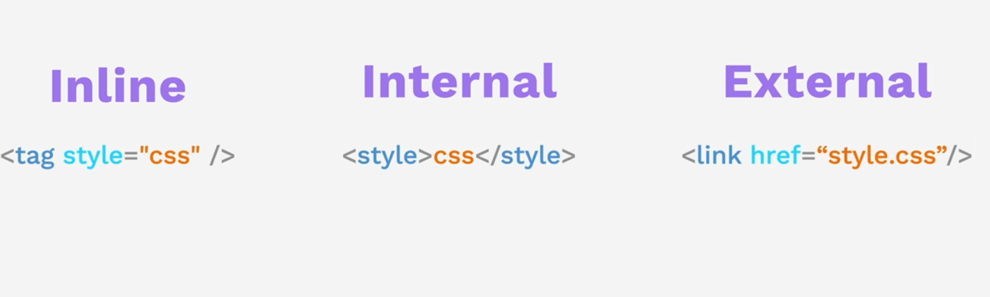
Method of Adding CSS

Slide 39

CSS Selector

Slide 40
Element Selector

Slide 41
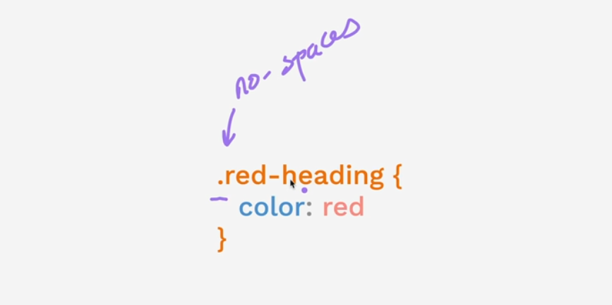
Class Selector

Slide 42

Id Selector

Slide 43

Attribute Selector

Slide 44

Universal Selector

Slide 45

CSS Properties

Slide 46
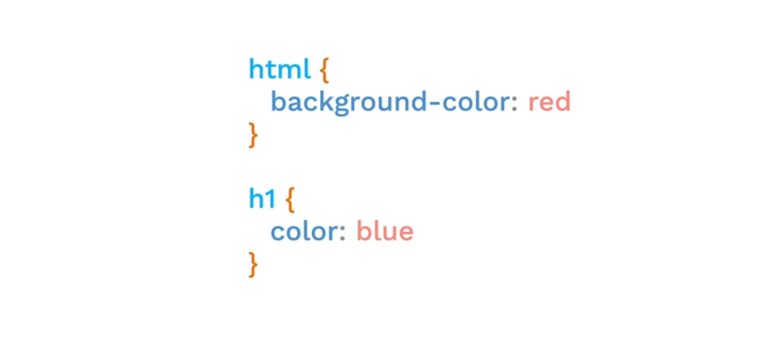
CSS - Color

Slide 47
CSS - Color

Slide 48
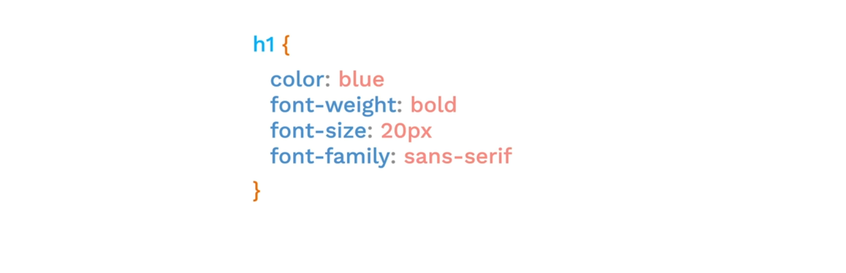
CSS - Font

Slide 49
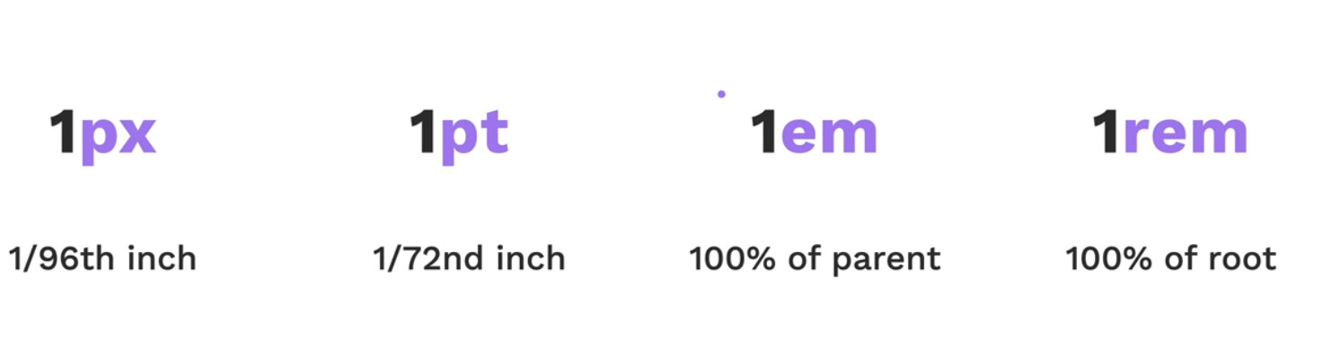
CSS – Font-size

Slide 50
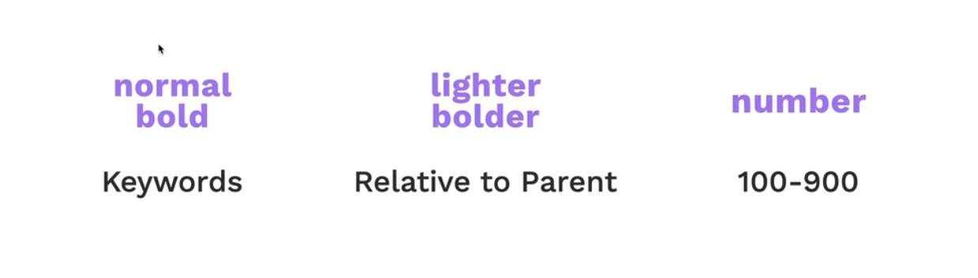
CSS – Font-weight

Slide 51

CSS – text-alignment

Slide 52
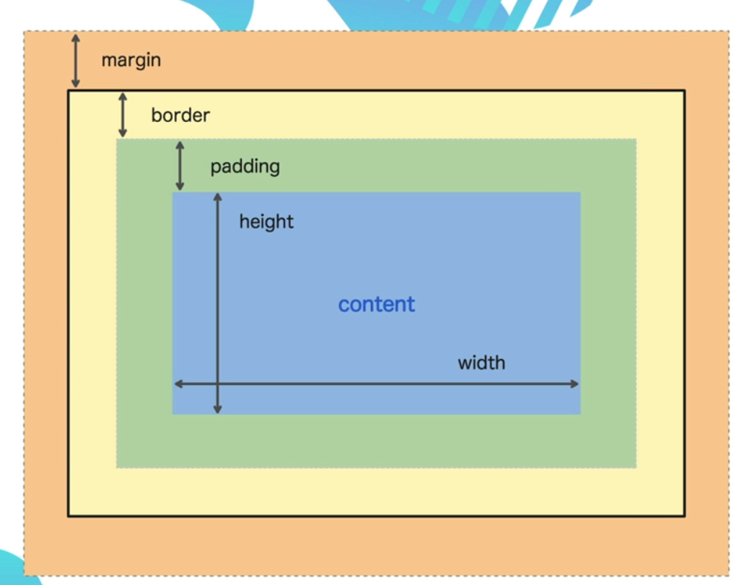
CSS – Box Model

Slide 53
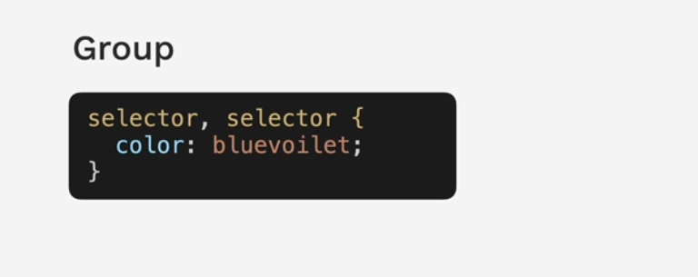
CSS – Grouping Selector

Slide 54
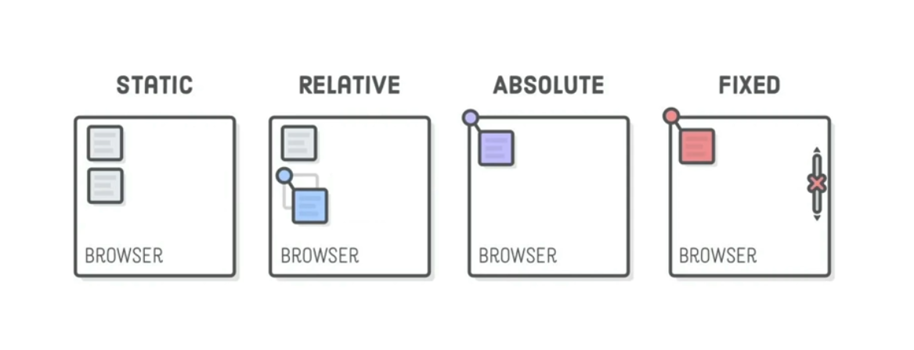
CSS – Positioning

Slide 55
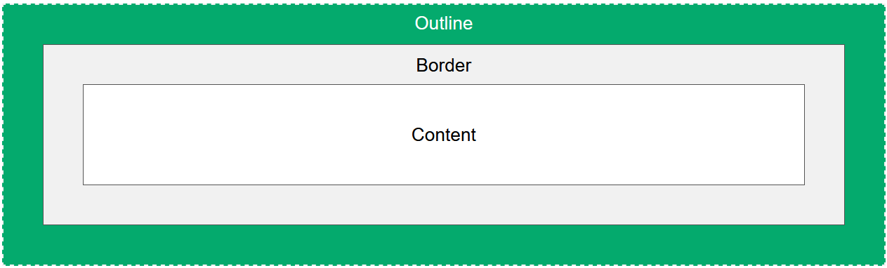
CSS – Outline
An outline is a line drawn outside the element's border.

Slide 56
CSS – Outline
An outline is a line drawn outside the element's border.
CSS has the following outline properties:
outline-style
outline-color
outline-width
outline-offset
outline
CSS Outline Style
The outline-style property specifies the style of the outline, and can have one of the following values:
dotted - Defines a dotted outline
dashed - Defines a dashed outline
solid - Defines a solid outline
double - Defines a double outline
groove - Defines a 3D grooved outline
ridge - Defines a 3D ridged outline
inset - Defines a 3D inset outline
outset - Defines a 3D outset outline
none - Defines no outline
hidden - Defines a hidden outline

Slide 57
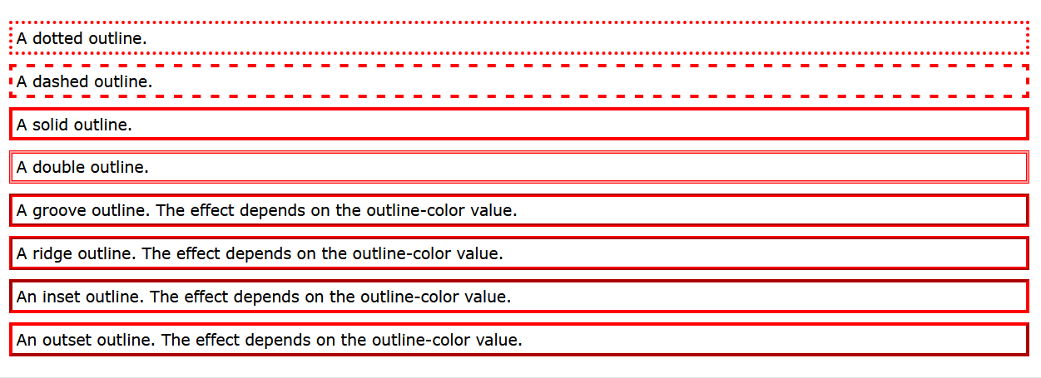
CSS – Outline
An outline is a line drawn outside the element's border.
p.dotted {outline-style: dotted;}
p.dashed {outline-style: dashed;}
p.solid {outline-style: solid;}
p.double {outline-style: double;}
p.groove {outline-style: groove;}
p.ridge {outline-style: ridge;}
p.inset {outline-style: inset;}
p.outset {outline-style: outset;}

Slide 58
CSS – CSS Outline Width
An outline is a line drawn outside the element's border.
The outline-width property specifies the width of the outline, and can have one of the following values:
thin (typically 1px)
medium (typically 3px)
thick (typically 5px)
A specific size (in px, pt, cm, em, etc)
p{
border: 1px solid black;
outline-style: solid;
outline-color: red;
outline-width: thin;
}

Slide 59
CSS – Table
table {
width: 100%;
}
table {
border-collapse: collapse;
}
Table Borders
Full-Width Table
Collapse Table Borders
Table Width and Height
Horizontal Alignment
Hoverable Table
table, th, td {
border: 1px solid;
}
td {
text-align: center;
}
table {
width: 100%;
}
th {
height: 70px;
}

Slide 60
CSS – Table
table {
width: 100%;
}
table {
border-collapse: collapse;
}
Table Borders
Full-Width Table
Collapse Table Borders
Table Width and Height
Horizontal Alignment
Hoverable Table
table, th, td {
border: 1px solid;
}
td {
text-align: center;
}
table {
width: 100%;
}
th {
height: 70px;
}

Slide 61
CSS Layout - The position Property
The position Property
The position property specifies the type of positioning method used for an element.
There are five different position values:
static
relative
fixed
absolute
sticky

Slide 62
CSS Layout - position: static
HTML elements are positioned static by default.
Static positioned elements are not affected by the top, bottom, left, and right properties.
An element with position: static; is not positioned in any special way; it is always positioned according to the normal flow of the page:
div.static {
position: static;
border: 3px solid #73AD21;
}

Slide 63
CSS Layout - position: Relative
An element with position: relative; is positioned relative to its normal position.
Setting the top, right, bottom, and left properties of a relatively-positioned element will cause it to be adjusted away from its normal position. Other content will not be adjusted to fit into any gap left by the element.
div.relative {
position: relative;
left: 30px;
border: 3px solid #73AD21;
}

Slide 64
CSS Layout - position: fixed
An element with position: fixed; is positioned relative to the viewport, which means it always stays in the same place even if the page is scrolled. The top, right, bottom, and left properties are used to position the element.
Notice the fixed element in the lower-right corner of the page. Here is the CSS that is used:
A fixed element does not leave a gap in the page where it would normally have been located
div.fixed {
position: fixed;
bottom: 0;
right: 0;
width: 300px;
border: 3px solid #73AD21;
}

Slide 65
CSS Layout - position: absolute
An element with position: absolute; is positioned relative to the nearest positioned ancestor (instead of positioned relative to the viewport, like fixed).
However; if an absolute positioned element has no positioned ancestors, it uses the document body, and moves along with page scrolling.
Note: Absolute positioned elements are removed from the normal flow, and can overlap elements.
div.absolute {
position: absolute;
top: 80px;
right: 0;
width: 200px;
height: 100px;
border: 3px solid #73AD21;
}

Slide 66
CSS Layout - position: sticky
An element with position: sticky; is positioned based on the user's scroll position.
A sticky element toggles between relative and fixed, depending on the scroll position. It is positioned relative until a given offset position is met in the viewport - then it "sticks" in place (like position:fixed)
div.sticky {
position: -webkit-sticky; /* Safari */
position: sticky;
top: 0;
background-color: green;
border: 2px solid #4CAF50;
}

Slide 67
CSS Navigation Bar
Navigation Bar = List of Links
A navigation bar needs standard HTML as a base.
In our examples we will build the navigation bar from a standard HTML list.
A navigation bar is basically a list of links, so using the <ul> and <li> elements makes perfect sense:
Now let's remove the bullets and the margins and padding from the list:
ul {
list-style-type: none;
margin: 0;
padding: 0;
}

Slide 68
CSS Navigation Bar
li a {
display: block;
color: #000;
padding: 8px 16px;
text-decoration: none;
}
/* Change the link color on hover */
li a:hover {
background-color: #555;
color: white;
}
Vertical Navigation Bar
ul {
list-style-type: none;
margin: 0;
padding: 0;
width: 200px;
background-color: #f1f1f1;
}

Slide 69
CSS Horizontal Navigation Bar
There are two ways to create a horizontal navigation bar. Using inline or floating list items.
Inline List Items
One way to build a horizontal navigation bar is to specify the <li> elements as inline, in addition to the "standard" code
Another way of creating a horizontal navigation bar is to float the <li> elements, and specify a layout for the navigation links:
Floating List Items

Slide 70
CSS Navigation Bar
li a {
display: block;
color: white;
text-align: center;
padding: 14px 16px;
text-decoration: none;
}
/* Change the link color to #111 (black) on hover */
li a:hover {
background-color: #111;
}
ul {
list-style-type: none;
margin: 0;
padding: 0;
overflow: hidden;
background-color: #333;
}
li {
float: left;
}

Slide 71
Part Three

Slide 72
Bootstrap

Slide 73
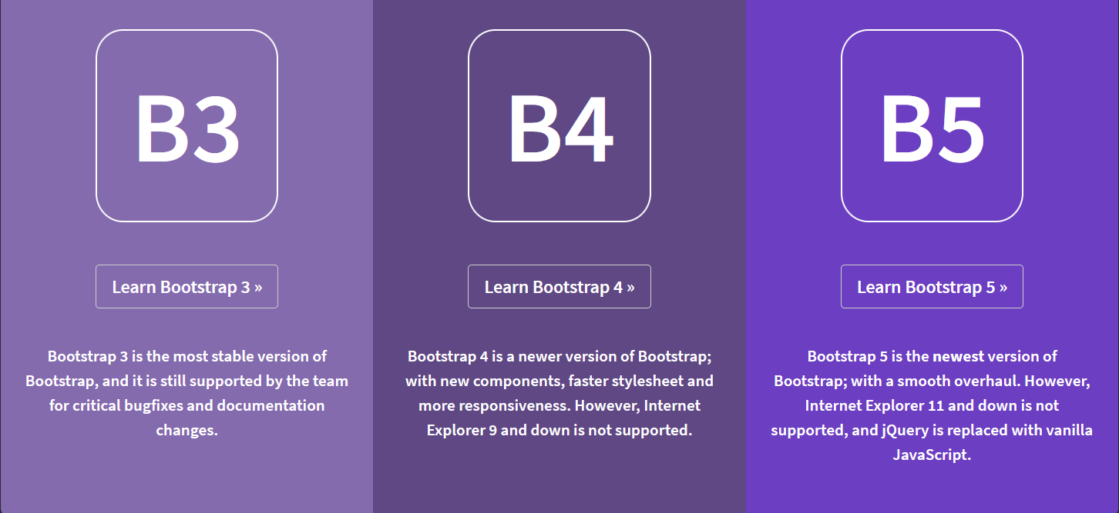

Slide 74
Bootstrap
What is Bootstrap?
Bootstrap is a free front-end framework for faster and easier web development
Bootstrap includes HTML and CSS based design templates for typography, forms, buttons, tables, navigation, modals, image carousels and many other, as well as optional JavaScript plugins
Bootstrap also gives you the ability to easily create responsive designs
What is Responsive Web Design?
Responsive web design is about creating web sites which automatically adjust themselves to look good on all devices, from small phones to large desktops

Slide 75
Bootstrap
Where to Get Bootstrap 4?
There are two ways to start using Bootstrap 4 on your own web site.
You can:
Include Bootstrap 4 from a CDN
Download Bootstrap 4 from getbootstrap.com
Bootstrap 5 CDN
If you don't want to download and host Bootstrap 5 yourself, you can include it from a CDN (Content Delivery Network).
jsDelivr provides CDN support for Bootstrap's CSS and JavaScript:

Slide 76
Bootstrap 5 CDN
<!-- Latest compiled and minified CSS -->
<link href="https://cdn.jsdelivr.net/npm/bootstrap@5.3.3/dist/css/bootstrap.min.css" rel="stylesheet">
<!-- Latest compiled JavaScript -->
<script src="https://cdn.jsdelivr.net/npm/bootstrap@5.3.3/dist/js/bootstrap.bundle.min.js"></script> :
<meta name="viewport" content="width=device-width, initial-scale=1">

Slide 77
Bootstrap 5 Containers
Containers are used to pad the content inside of them, and there are two container classes available:
The .container class provides a responsive fixed width container
The .container-fluid class provides a full width container, spanning the entire width of the viewport
Container Padding
By default, containers have left and right padding, with no top or bottom padding. Therefore, we often use spacing utilities, such as extra padding and margins to make them look even better. For example, .pt-5 means "add a large top padding":
<div class="container pt-5"></div>

Slide 78
Bootstrap 5 Containers
Container Border and Color
By default, containers have left and right padding, with no top or bottom padding. Therefore, we often use spacing utilities, such as extra padding and margins to make them look even better. For example, .pt-5 means "add a large top padding":
<div class="container p-5 my-5 border"></div>
<div class="container p-5 my-5 bg-dark text-white"></div>
<div class="container p-5 my-5 bg-primary text-white"></div>

Slide 79
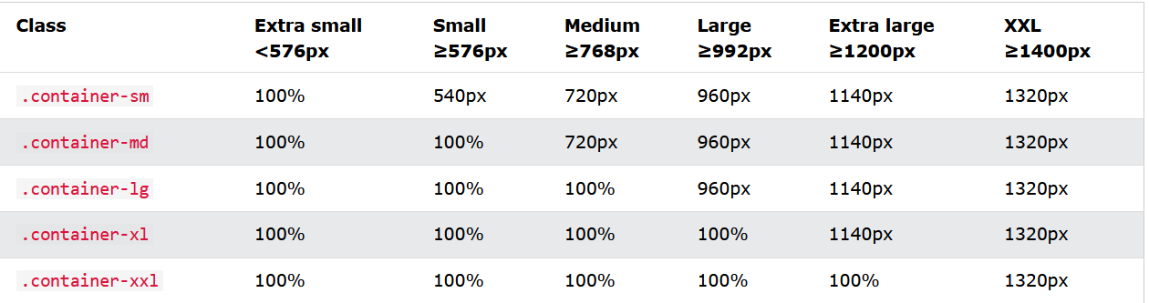
Bootstrap 5 Containers
Responsive Containers
You can also use the .container-sm|md|lg|xl classes to determine when the container should be responsive.
The max-width of the container will change on different screen sizes/viewports:

Slide 80
Bootstrap 5 Containers
Responsive Containers
<div class="container-sm">.container-sm</div> <div class="container-md">.container-md</div> <div class="container-lg">.container-lg</div> <div class="container-xl">.container-xl</div> <div class="container-xxl">.container-xxl</div>

Slide 81
Bootstrap Grid System
Bootstrap's grid system is built with flexbox and allows up to 12 columns across the page.
If you do not want to use all 12 columns individually, you can group the columns together to create wider columns:
The grid system is responsive, and the columns will re-arrange automatically depending on the screen size.
Make sure that the sum adds up to 12 or fewer (it is not required that you use all 12 available columns).

Slide 82
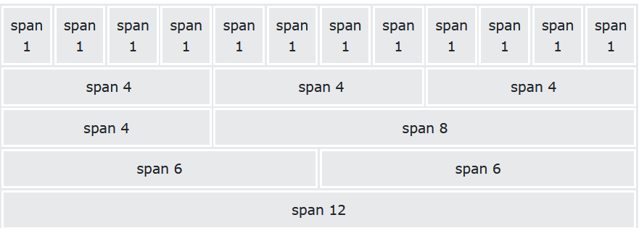
Bootstrap Grid System

Slide 83
Bootstrap Grid System

Slide 84
Bootstrap Grid System
Equal Columns
<div class="container-fluid mt-3">
<div class="row">
<div class="col-sm-3 p-3 bg-primary text-white">.col</div>
<div class="col-sm-3 p-3 bg-dark text-white">.col</div>
<div class="col-sm-3 p-3 bg-primary text-white">.col</div>
<div class="col-sm-3 p-3 bg-dark text-white">.col</div>
</div>
</div>

Slide 85
Bootstrap Grid System
Unequal Columns
<div class="container-fluid mt-3">
<div class="row">
<div class="col-sm-4 p-3 bg-primary text-white">.col</div>
<div class="col-sm-8 p-3 bg-dark text-white">.col</div>
</div>
</div>

Slide 86
Bootstrap Color
Bootstrap 5 has some contextual classes that can be used to provide "meaning through colors".
The classes for text colors are: .text-muted, .text-primary, .text-success, .text-info, .text-warning, .text-danger, .text-secondary, .text-white, .text-dark, .text-body (default body color/often black) and .text-light:

Slide 87
Bootstrap Color
<div class="container mt-3">
<h2>Contextual Colors</h2>
<p>Use the contextual classes to provide "meaning through colors":</p>
<p class="text-muted">This text is muted.</p>
<p class="text-primary">This text is important.</p>
<p class="text-success">This text indicates success.</p>
<p class="text-info">This text represents some information.</p>
<p class="text-warning">This text represents a warning.</p>
<p class="text-danger">This text represents danger.</p>
<p class="text-secondary">Secondary text.</p>
<p class="text-dark">This text is dark grey.</p>
<p class="text-body">Default body color (often black).</p>
<p class="text-light">This text is light grey (on white background).</p>
<p class="text-white">This text is white (on white background).</p>
</div>

Slide 88
Bootstrap Color
Background Colors
The classes for background colors are: .bg-primary, .bg-success, .bg-info, .bg-warning, .bg-danger, .bg-secondary, .bg-dark and .bg-light.

Slide 89
Bootstrap Color
<div class="container mt-3">
<h2>Contextual Backgrounds</h2>
<p>Use the contextual background classes to provide "meaning through colors".</p>
<div class="bg-primary p-3"></div>
<div class="bg-success p-3"></div>
<div class="bg-info p-3"></div>
<div class="bg-warning p-3"></div>
<div class="bg-danger p-3"></div>
<div class="bg-secondary p-3"></div>
<div class="bg-dark p-3"></div>
<div class="bg-light p-3"></div>
</div>

Slide 90
Bootstrap Color
The .bg-color classes above does not work well with text, or atleast then you have to specify a proper .text-color class to get the right text color for each background.
However, you can use the .text-bg-color classes and Bootstrap will automatically handle the appropriate text color for each background color:

Slide 91
Bootstrap Color
<div class="container mt-3">
<h2>Background Color with Contrasting Text Color</h2>
<p class="text-bg-primary">This text is important.</p>
<p class="text-bg-success">This text indicates success.</p>
<p class="text-bg-info">This text represents some information.</p>
<p class="text-bg-warning">This text represents a warning.</p>
<p class="text-bg-danger">This text represents danger.</p>
<p class="text-bg-secondary">Secondary background color.</p>
<p class="text-bg-dark">Dark grey background color.</p>
<p class="text-bg-light">Light grey background color.</p>
</div>

Slide 92
Bootstrap Table
A basic Bootstrap table has a light padding and horizontal dividers.
The .table class adds basic styling to a table:
<table class="table">
Striped Rows
The .table-striped class adds zebra-stripes to a table:
<table class="table table-striped">

Slide 93
Bootstrap Table
Bordered Table
The .table-bordered class adds borders on all sides of the table and cells:
<table class="table table-bordered">
Hover Rows
<table class="table table-hover">
Borderless Table
<table class="table table-borderless">

Slide 94
Bootstrap Table
Contextual Classes
Contextual classes can be used to color the whole table (<table>), the table rows (<tr>) or table cells (<td>).

Slide 95
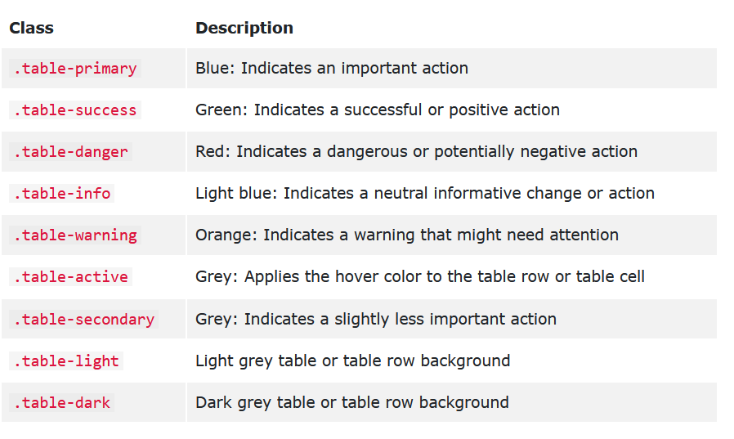
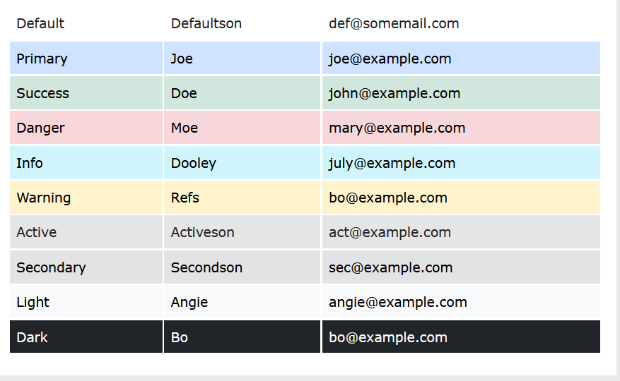
Bootstrap Table

Slide 96
Bootstrap Table
Responsive Tables
The .table-responsive class adds a scrollbar to the table when needed (when it is too big horizontally):

Slide 97
Bootstrap Table
<tbody>
<tr>
<td>1</td>
<td>Anna</td>
<td>Pitt</td>
<td>35</td>
<td>New York</td>
<td>USA</td>
<td>Female</td>
<td>Yes</td>
<td>Yes</td>
<td>Yes</td>
<td>Yes</td>
<td>Yes</td>
<td>Yes</td>
<td>Yes</td>
<td>Yes</td>
<td>Yes</td>
<div class="table-responsive">
<table class="table table-bordered">
<thead>
<tr>
<th>#</th>
<th>Firstname</th>
<th>Lastname</th>
<th>Age</th>
<th>City</th>
<th>Country</th>
<th>Sex</th>
<th>Example</th>
<th>Example</th>
<th>Example</th>
<th>Example</th>
<th>Example</th>
<th>Example</th>
<th>Example</th>
<th>Example</th>
<th>Example</th>
<th>Example</th>
<th>Example</th>
<th>Example</th>
</tr>
</thead>
<td>Yes</td>
<td>Yes</td>
<td>Yes</td>
</tr>
</tbody>
</table>
</div>
</div>

Slide 98
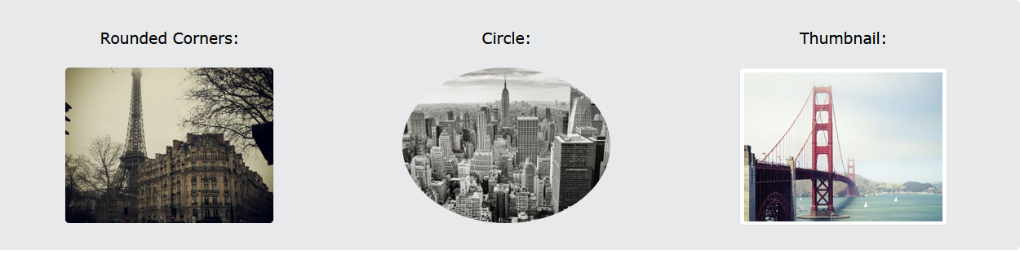
Bootstrap Image
Image Shapes

Slide 99
Bootstrap Image
Rounded Corners
The .rounded class adds rounded corners to an image:
<img src="cinqueterre.jpg" class="rounded" alt="Cinque Terre">
Circle
The .rounded-circle class shapes the image to a circle:
<img src="cinqueterre.jpg" class="rounded-circle" alt="Cinque Terre">

Slide 100
Bootstrap Image
Thumbnail
The .img-thumbnail class shapes the image to a thumbnail (bordered):
<img src="cinqueterre.jpg" class="img-thumbnail" alt="Cinque Terre">

Slide 101
Bootstrap Image
Aligning Images
Float an image to the left with the .float-start class or to the right with .float-end:
<div class="container mt-3">
<img src="paris.jpg" class="float-start" alt="Paris" width="304" height="236">
<img src="paris.jpg" class="float-end" alt="Paris" width="304" height="236">
</div>

Slide 102
Bootstrap Image
Center Images
Center an image by adding the utility classes .mx-auto (margin:auto) and .d-block
<img src="paris.jpg" class="mx-auto d-block" style="width:50%">

Slide 103
Bootstrap Image
Responsive Images
Images come in all sizes. So do screens. Responsive images automatically adjust to fit the size of the screen.
Create responsive images by adding an .img-fluid class to the <img> tag. The image will then scale nicely to the parent element.
The .img-fluid class applies max-width: 100%; and height: auto; to the image:
<img class="img-fluid" src="ny.jpg" alt="New York" width="1100" height="500">

Slide 104
Bootstrap Button
<button type="button" class="btn">Basic</button>
<button type="button" class="btn btn-primary">Primary</button>
<button type="button" class="btn btn-secondary">Secondary</button>
<button type="button" class="btn btn-success">Success</button>
<button type="button" class="btn btn-info">Info</button>
<button type="button" class="btn btn-warning">Warning</button>
<button type="button" class="btn btn-danger">Danger</button>
<button type="button" class="btn btn-dark">Dark</button>
<button type="button" class="btn btn-light">Light</button>
<button type="button" class="btn btn-link">Link</button>

Slide 105
Bootstrap Button-Outline
Bootstrap 5 also provides eight outline/bordered buttons.
Move the mouse over them to see an additional "hover" effect:
<div class="container mt-3">
<h2>Button Outline</h2>
<button type="button" class="btn btn-outline-primary">Primary</button>
<button type="button" class="btn btn-outline-secondary">Secondary</button>
<button type="button" class="btn btn-outline-success">Success</button>
<button type="button" class="btn btn-outline-info">Info</button>
<button type="button" class="btn btn-outline-warning">Warning</button>
<button type="button" class="btn btn-outline-danger">Danger</button>
<button type="button" class="btn btn-outline-dark">Dark</button>
<button type="button" class="btn btn-outline-light text-dark">Light</button>
</div>

Slide 106

Bootstrap Button-Size
<button type="button" class="btn btn-primary btn-lg">Large</button>
<button type="button" class="btn btn-primary">Default</button>
<button type="button" class="btn btn-primary btn-sm">Small</button>

Slide 107
Bootstrap Button
<button type="button" class="btn btn-primary btn-lg">Large</button>
<button type="button" class="btn btn-primary">Default</button>
<button type="button" class="btn btn-primary btn-sm">Small</button>

Slide 108
Active/Disabled Buttons
A button can be set to an active (appear pressed) or a disabled (unclickable) state:
The class .active makes a button appear pressed, and the disabled attribute makes a button unclickable. Note that <a> elements do not support the disabled attribute and must therefore use the .disabled class to make it visually appear disabled.
<button type="button" class="btn btn-primary active">Active Primary</button> <button type="button" class="btn btn-primary" disabled>Disabled Primary</button> <a href="#" class="btn btn-primary disabled">Disabled Link</a>

Slide 109

Spinner Buttons
<button class="btn btn-primary">
<span class="spinner-border spinner-border-sm"></span>
</button>
<button class="btn btn-primary">
<span class="spinner-border spinner-border-sm"></span>
Loading..
</button>
<button class="btn btn-primary" disabled>
<span class="spinner-border spinner-border-sm"></span>
Loading..
</button>
<button class="btn btn-primary" disabled>
<span class="spinner-grow spinner-grow-sm"></span>
Loading..
</button>

Slide 110
segate.g@gmail.com

Slide 111
Spinner Buttons
Spinners
To create a spinner/loader, use the .spinner-border class:
<div class="spinner-border"></div>
Growing Spinners
<div class="spinner-grow text-muted"></div>
<div class="spinner-grow text-primary"></div>
<div class="spinner-grow text-success"></div>
<div class="spinner-grow text-info"></div>
<div class="spinner-grow text-warning"></div>
<div class="spinner-grow text-danger"></div>
<div class="spinner-grow text-secondary"></div>
<div class="spinner-grow text-dark"></div>
<div class="spinner-grow text-light"></div>
Colored Spinners
<div class="spinner-border text-muted"></div>
<div class="spinner-border text-primary"></div>
<div class="spinner-border text-success"></div>
<div class="spinner-border text-info"></div>
<div class="spinner-border text-warning"></div>
<div class="spinner-border text-danger"></div>
<div class="spinner-border text-secondary"></div>
<div class="spinner-border text-dark"></div>
<div class="spinner-border text-light"></div>

Slide 112
Dropdown
<div class="spinn<div class="dropdown">
<button type="button" class="btn btn-primary dropdown-toggle" data-bs-toggle="dropdown">
Dropdown button
</button>
<ul class="dropdown-menu">
<li><a class="dropdown-item" href="#">Link 1</a></li>
<li><a class="dropdown-item" href="#">Link 2</a></li>
<li><a class="dropdown-item" href="#">Link 3</a></li>
</ul>
</div>
er-border text-muted"></div>
<div class="spinner-border text-primary"></div>
<div class="spinner-border text-success"></div>
<div class="spinner-border text-info"></div>
<div class="spinner-border text-warning"></div>
<div class="spinner-border text-danger"></div>
<div class="spinner-border text-secondary"></div>
<div class="spinner-border text-dark"></div>
<div class="spinner-border text-light"></div>
Disable and Active items
<li><a class="dropdown-item" href="#">Normal</a></li>
<li><a class="dropdown-item active" href="#">Active</a></li>
<li><a class="dropdown-item disabled" href="#">Disabled</a></li>

Slide 113
Nav Menus
Left-aligned nav
<div class="container mt-3">
<h2>Nav</h2>
<p>Left-aligned nav (default):</p>
<ul class="nav">
<li class="nav-item">
<a class="nav-link" href="#">Link</a>
</li>
<li class="nav-item">
<a class="nav-link" href="#">Link</a>
</li>
<li class="nav-item">
<a class="nav-link" href="#">Link</a>
</li>
<li class="nav-item">
<a class="nav-link disabled" href="#">Disabled</a>
</li>
</ul>
Center-aligned
<p class="text-center">Centered nav:</p>
<ul class="nav justify-content-center">
<li class="nav-item">
<a class="nav-link" href="#">Link</a>
</li>
<li class="nav-item">
<a class="nav-link" href="#">Link</a>
</li>
<li class="nav-item">
<a class="nav-link" href="#">Link</a>
</li>
<li class="nav-item">
<a class="nav-link disabled" href="#">Disabled</a>
</li>
</ul>

Slide 114
Nav Menus
Right-aligned nav
<p class="text-end">Right-aligned nav:</p>
<ul class="nav justify-content-end">
<li class="nav-item">
<a class="nav-link" href="#">Link</a>
</li>
<li class="nav-item">
<a class="nav-link" href="#">Link</a>
</li>
<li class="nav-item">
<a class="nav-link" href="#">Link</a>
</li>
<li class="nav-item">
<a class="nav-link disabled" href="#">Disabled</a>
</li>
</ul>

Slide 115
Colored Navbar
<nav class="navbar navbar-expand-sm bg-primary navbar-dark">
<div class="container-fluid">
<ul class="navbar-nav">
<li class="nav-item">
<a class="nav-link active" href="#">Active</a>
</li>
<li class="nav-item">
<a class="nav-link" href="#">Link</a>
</li>
<li class="nav-item">
<a class="nav-link" href="#">Link</a>
</li>
<li class="nav-item">
<a class="nav-link disabled" href="#">Disabled</a>
</li>
</ul>
</div>
</nav>

Slide 116
Slide Show
<nav class="navbar navbar-expand-sm bg-primary navbar-dark">
<div class="container-fluid">
<ul class="navbar-nav">
<li class="nav-item">
<a class="nav-link active" href="#">Active</a>
</li>
<li class="nav-item">
<a class="nav-link" href="#">Link</a>
</li>
<li class="nav-item">
<a class="nav-link" href="#">Link</a>
</li>
<li class="nav-item">
<a class="nav-link disabled" href="#">Disabled</a>
</li>
</ul>
</div>
</nav>

Slide 117
Part Four

Slide 118
Git and GitHub

Slide 119
Git and GitHub
What is Git? Git is a popular version control system. It was created by Linus Torvalds in 2005, and has been maintained by Junio Hamano since then. It is used for: Tracking code changes Tracking who made changes Coding collaboration
What does Git do?
Manage projects with Repositories
Clone a project to work on a local copy
Control and track changes with Staging and Committing
Branch and Merge to allow for work on different parts and versions of a project
Pull the latest version of the project to a local copy
Push local updates to the main project

Slide 120
Git and GitHub
Working with Git
Initialize Git on a folder, making it a Repository
Git now creates a hidden folder to keep track of changes in that folder
When a file is changed, added or deleted, it is considered modified
You select the modified files you want to Stage
The Staged files are Committed, which prompts Git to store a permanent snapshot of the files
Git allows you to see the full history of every commit.
You can revert back to any previous commit.
Git does not store a separate copy of every file in every commit, but keeps track of changes made in each commit!
Why Git?
Over 70% of developers use Git!
Developers can work together from anywhere in the world.
Developers can see the full history of the project.
Developers can revert to earlier versions of a project.

Slide 121
Git and GitHub
Working with Git
Git is not the same as GitHub.
GitHub makes tools that use Git.
GitHub is the largest host of source code in the world, and has been owned by Microsoft since 2018.
Using Git with Command Line
To start using Git, we are first going to open up our Command shell.
For Windows, you can use Git bash, which comes included in Git for Windows. For Mac and Linux you can use the built-in terminal.
The first thing we need to do, is to check if Git is properly installed:
git --version

Slide 122
Git and GitHub
Configure Git
git config --global user.name "username"
git config --global user.email "email“
pwd
Creating Git Folder
mkdir myproject
cd myproject
Initialize Git
git init

Slide 123
Git and GitHub
Git Adding New Files
You just created your first local Git repo. But it is empty.
So let's add some files, or create a new file using your favourite text editor. Then save or move it to the folder you just created.
git status

Slide 124
Git and GitHub
Git Staging Environment
One of the core functions of Git is the concepts of the Staging Environment, and the Commit.
As you are working, you may be adding, editing and removing files. But whenever you hit a milestone or finish a part of the work, you should add the files to a Staging Environment.
Staged files are files that are ready to be committed to the repository you are working on. You will learn more about commit shortly.
git add index.html
git status

Slide 125
Git and GitHub
Git Commit
Since we have finished our work, we are ready move from stage to commit for our repo.
Adding commits keep track of our progress and changes as we work. Git considers each commit change point or "save point". It is a point in the project you can go back to if you find a bug, or want to make a change.
When we commit, we should always include a message
git commit -m "First release of Hello World!"

Slide 126
Git and GitHub
Git Help
If you are having trouble remembering commands or options for commands, you can use Git help.
There are a couple of different ways you can use the help command in command line:
git command -help - See all the available options for the specific command
git help --all - See all possible commands

Slide 127
Git and GitHub
Git Branch
Branches allow you to work on different parts of a project without impacting the main branch.
When the work is complete, a branch can be merged with the main project.
You can even switch between branches and work on different projects without them interfering with each other.
Branching in Git is very lightweight and fast
git branch hello-world-images
Git Branch Merge
git merge emergency-fix

Slide 128
Git and GitHub
Create a Repository on GitHub
Edit Code in GitHub
Fork a Repository
Git Clone from GitHub

Slide 129
Part Five

Slide 130
JAVASCRIPT

Slide 131
document.body.innerHTML = "hello“ B P O E D M M D A A S S

Slide 132
JavaScript Fundamentals
The “script” tag
JavaScript programs can be inserted almost anywhere into an HTML document using the <script> tag.
<!DOCTYPE HTML>
<html>
<body>
<p>Before the script...</p>
<script>
alert( 'Hello, world!' );
</script>
<p>...After the script.</p>
</body>
</html>

Slide 133
JavaScript Fundamentals
External scripts
Script files are attached to HTML with the src attribute:
<script src="/path/to/script.js"></script>
Here, /path/to/script.js is an absolute path to the script from the site root. One can also provide a relative path from the current page. For instance, src="script.js", just like src="./script.js", would mean a file "script.js" in the current folder.

Slide 134
JavaScript Fundamentals
Statements
Statements are syntax constructs and commands that perform actions.
We’ve already seen a statement, alert('Hello, world!'), which shows the message “Hello, world!”.
We can have as many statements in our code as we want. Statements can be separated with a semicolon.
For example, here we split “Hello World” into two alerts:
alert('Hello'); alert('World');
Usually, statements are written on separate lines to make the code more readable:
alert('Hello');
alert('World');
Code structure

Slide 135
JavaScript Fundamentals
Comments
As time goes on, programs become more and more complex. It becomes necessary to add comments which describe what the code does and why.
Comments can be put into any place of a script. They don’t affect its execution because the engine simply ignores them.
One-line comments start with two forward slash characters //.
The rest of the line is a comment. It may occupy a full line of its own or follow a statement.
Like here:
// This comment occupies a line of its own
alert('Hello');
alert('World'); // This comment follows the statement
Code structure

Slide 136
JavaScript Fundamentals
Multiline comments start with a forward slash and an asterisk /* and end with an asterisk and a forward slash */.
Like this:
/* An example with two messages.
This is a multiline comment.
*/
alert('Hello');
alert('World');
The content of comments is ignored, so if we put code inside /* … */, it won’t execute.
Code structure

Slide 137
JavaScript Fundamentals
Variables
Most of the time, a JavaScript application needs to work with information. Here are two examples:
An online shop – the information might include goods being sold and a shopping cart.
A chat application – the information might include users, messages, and much more.
Variables are used to store this information.
A variable
A variable is a “named storage” for data. We can use variables to store goodies, visitors, and other data.
Variables

Slide 138
JavaScript Fundamentals
To create a variable in JavaScript, use the let keyword.
The statement below creates (in other words: declares) a variable with the name “message”:
let message;
Now, we can put some data into it by using the assignment operator =:
let message;
message = 'Hello'; // store the string 'Hello' in the variable named message
alert(message); // shows the variable content
Variables

Slide 139
JavaScript Fundamentals
We can also declare multiple variables in one line:
let user = 'John', age = 25, message = 'Hello';
That might seem shorter, but we don’t recommend it. For the sake of better readability, please use a single line per variable.
The multiline variant is a bit longer, but easier to read:
let user = 'John';
let age = 25;
let message = 'Hello';
Variables

Slide 140
JavaScript Fundamentals
Variable naming
There are two limitations on variable names in JavaScript:
The name must contain only letters, digits, or the symbols $ and _.
The first character must not be a digit.
Examples of valid names:
let userName;
let test123;
Variables

Slide 141
JavaScript Fundamentals
When the name contains multiple words, camelCase is commonly used. That is: words go one after another, each word except first starting with a capital letter: myVeryLongName.
What’s interesting – the dollar sign '$' and the underscore '_' can also be used in names. They are regular symbols, just like letters, without any special meaning.
These names are valid:
let $ = 1; // declared a variable with the name "$"
let _ = 2; // and now a variable with the name "_"
alert($ + _); // 3
Variables

Slide 142
JavaScript Fundamentals
Case matters
Variables named apple and APPLE are two different variables.
Constants
To declare a constant (unchanging) variable, use const instead of let:
const myBirthday = '18.04.1982';
Variables declared using const are called “constants”. They cannot be reassigned. An attempt to do so would cause an error:
const myBirthday = '18.04.1982';
myBirthday = '01.01.2001'; // error, can't reassign the constant!
Variables

Slide 143
JavaScript Fundamentals
Name things right
Some good-to-follow rules are:
Use human-readable names like userName or shoppingCart.
Stay away from abbreviations or short names like a, b, and c, unless you know what you’re doing.
Make names maximally descriptive and concise. Examples of bad names are data and value. Such names say nothing. It’s only okay to use them if the context of the code makes it exceptionally obvious which data or value the variable is referencing.
Agree on terms within your team and in your mind. If a site visitor is called a “user” then we should name related variables currentUser or newUser instead of currentVisitor or newManInTown.
Variables

Slide 144
JavaScript Fundamentals
Name things right
Some good-to-follow rules are:
Use human-readable names like userName or shoppingCart.
Stay away from abbreviations or short names like a, b, and c, unless you know what you’re doing.
Make names maximally descriptive and concise. Examples of bad names are data and value. Such names say nothing. It’s only okay to use them if the context of the code makes it exceptionally obvious which data or value the variable is referencing.
Agree on terms within your team and in your mind. If a site visitor is called a “user” then we should name related variables currentUser or newUser instead of currentVisitor or newManInTown.
Variables

Slide 145
TASK ONE
Declare two variables: admin and name.
Assign the value "John" to name.
Copy the value from name to admin.
Show the value of admin using alert (must output “John”).

Slide 146
JavaScript Fundamentals
Variables are Containers for Storing Data
JavaScript Variables can be declared in 4 ways:
Automatically
Using var
Using let
Using const
Variables

Slide 147
JavaScript Fundamentals
Automatically
They are automatically declared when first used
x = 5;
y = 6;
z = x + y;
document.getElementById("demo").innerHTML =
"The value of z is: " + z;
Variables

Slide 148
JavaScript Fundamentals
Using Var
The var keyword was used in all JavaScript code from 1995 to 2015.
The let and const keywords were added to JavaScript in 2015.
The var keyword should only be used in code written for older browsers.
var x = 5;
var y = 6;
var z = x + y;
document.getElementById("demo").innerHTML =
"The value of z is: " + z;
Variables

Slide 149
JavaScript Fundamentals
Using const
The two variables price1 and price2 are declared with the const keyword.
These are constant values and cannot be changed.
The variable total is declared with the let keyword.
The value total can be changed.
const price1 = 5;
const price2 = 6;
let total = price1 + price2;
document.getElementById("demo").innerHTML =
"The total is: " + total;
Variables

Slide 150
JavaScript Fundamentals
When to Use var, let, or const?
1. Always declare variables
2. Always use const if the value should not be changed
3. Always use const if the type should not be changed (Arrays and Objects)
4. Only use let if you can't use const
5. Only use var if you MUST support old browsers.
Variables

Slide 151
JavaScript Fundamentals
JavaScript has 8 Datatypes
String
Number
Bigint
Boolean
Undefined
Null
Symbol
Object
DATA TYPE

Slide 152
JavaScript Fundamentals
Primitive Data Types
Primitive data types are simple, immutable types that hold a single value. When a primitive value is assigned to a variable, the variable holds that value directly. Any operations on a primitive value create a new value; the original value remains unchanged.
DATA TYPE

Slide 153
JavaScript Fundamentals
a. NUMBER
Represents numeric values, including integers and floating-point numbers. JavaScript uses the IEEE-754 standard to represent numbers, so all numbers are stored as 64-bit floating-point values (commonly referred to as "double-precision").
let age = 25; // Integer
let price = 99.99; // Floating-point number
let negative = -10; // Negative number
let infinityVal = Infinity; // Positive infinity
let notANumber = NaN; // Not a Number (invalid number operation)
DATA TYPE

Slide 154
JavaScript Fundamentals
Special Number Values:
Infinity: Results from dividing a positive number by 0.
-Infinity: Results from dividing a negative number by 0.
NaN (Not a Number): Represents an invalid numeric result (e.g., dividing zero by zero or attempting arithmetic with non-numeric strings).
Common Operations:
Arithmetic (+, -, *, /, %).
Comparison (>, <, >=, <=).
Modulus (%) for remainder calculations.
Potential Issues:
Precision errors can arise due to the way floating-point numbers are handled.
console.log(0.1 + 0.2); // Expected: 0.3, Actual: 0.30000000000000004
DATA TYPE

Slide 155
JavaScript Fundamentals
String
Represents a sequence of characters (text). Strings in JavaScript are immutable, meaning any operations on a string result in the creation of a new string rather than modification of the original.
Examples:
let name = 'John'; // Single quotes
let greeting = "Hello, World!"; // Double quotes
let template = `Hello, ${name}`; // Template literal with interpolation
DATA TYPE

Slide 156
JavaScript Fundamentals
Properties:
Strings are indexed, meaning each character has a position (starting from 0).
let word = 'hello';
console.log(word[1]); // Output: 'e'
Strings can be concatenated using the + operator or template literals.
let fullName = 'John' + ' ' + 'Doe'; // 'John Doe'
let message = `Welcome, ${fullName}`; // 'Welcome, John Doe'
DATA TYPE

Slide 157
JavaScript Fundamentals
Boolean
Represents logical values: either true or false. Booleans are often used in conditions, loops, and comparisons.
Examples:
let isCompleted = true;
let isActive = false;
DATA TYPE

Slide 158
JavaScript Fundamentals
Undefined
A variable is of type undefined when it has been declared but not assigned a value. This is the default value for uninitialized variables.
Example:
let someVar;
console.log(someVar); // undefined
DATA TYPE

Slide 159
JavaScript Fundamentals
Use Cases:
Commonly used to represent variables that have yet to be initialized or when a function does not explicitly return a value.
It can also be checked in conditional statements to determine whether a value has been assigned:
if (typeof someVar === 'undefined') {
console.log('Variable is undefined.');
}
DATA TYPE

Slide 160
JavaScript Fundamentals
Null
null represents the intentional absence of any value or object. It is often used to signify an empty or non-existent reference.
Example:
let result = null;
Key Points:
Unlike undefined, which is assigned by the JavaScript engine to uninitialized variables, null is explicitly assigned by the developer.
Though it represents an object reference, typeof null returns "object". This is an acknowledged quirk of the language.
DATA TYPE

Slide 161
JavaScript Fundamentals
Symbol
Introduced in ECMAScript 6 (ES6), Symbol is a unique and immutable data type that is used to create unique identifiers for object properties. No two symbols are alike, even if they have the same description.
Example:
let sym1 = Symbol('description');
let sym2 = Symbol('description');
console.log(sym1 === sym2); // false
Use Cases:
Symbols are primarily used to avoid property name collisions in objects and to implement "private" object properties.
DATA TYPE

Slide 162
JavaScript Fundamentals
BigInt
Introduced in ECMAScript 2020 (ES11), BigInt is a built-in object that provides a way to represent whole numbers larger than 2^53 - 1 (which is the largest number JavaScript can safely represent with the Number type).
Example:
let bigNumber = 123456789012345678901234567890n;
Key Points:
BigInts are created by appending n to the end of an integer.
BigInt arithmetic works similarly to normal numbers, but you cannot mix BigInts with regular numbers.
DATA TYPE

Slide 163
JavaScript Fundamentals
Non-Primitive (Reference) Data Types
Non-primitive types are more complex, as they refer to objects or collections of values. When you assign a non-primitive type to a variable, the variable holds a reference to the location in memory where the object is stored, not the actual value itself. These types are mutable, meaning their values can be changed.
DATA TYPE

Slide 164
JavaScript Fundamentals
Object
Objects are collections of properties, where each property is a key-value pair. Objects can represent more complex structures, such as a collection of related data.
Example:
let person = {
name: 'Alice',
age: 30,
greet: function() {
console.log('Hello!');
}
};
DATA TYPE

Slide 165
JavaScript Fundamentals
Object
Key Points:
Properties in an object are accessed using dot notation or bracket notation.
console.log(person.name); // Output: 'Alice'
console.log(person['age']); // Output: 30
Objects can contain properties of any data type, including other objects, arrays, and functions.
Objects are mutable, meaning their properties can be updated or added dynamically.
DATA TYPE

Slide 166
JavaScript Fundamentals
Array
Arrays are a special type of object designed for storing ordered collections of values. JavaScript arrays are dynamic, meaning they can grow and shrink as needed, and can contain elements of different types.
Example:
let numbers = [1, 2, 3, 4, 5];
let mixedArray = [1, 'apple', true, { name: 'object' }];
DATA TYPE

Slide 167
JavaScript Fundamentals
Array
Key Points:
Arrays are zero-indexed, meaning the first element is at index 0.
Arrays are often used with looping constructs (e.g., for, forEach):
numbers.forEach(function(number) {
console.log(number);
});
Arrays are mutable, so elements can be added, removed, or changed at any time.
numbers.push(6); // Adds 6 to the end of the array
DATA TYPE

Slide 168
JavaScript Fundamentals
Type Checking and Type Conversion
JavaScript provides tools to check and convert types, allowing developers to handle values more effectively and safely.
Type Checking
You can use the typeof operator to determine the data type of a value.
Examples:
console.log(typeof 42); // "number"
console.log(typeof 'hello'); // "string"
console.log(typeof true); // "boolean"
console.log(typeof undefined); // "undefined"
console.log(typeof null); // "object" (quirk of JS)
DATA TYPE

Slide 169
JavaScript Fundamentals
Type Conversion
JavaScript automatically converts types in certain operations (coercion), but it is also possible to perform explicit type conversions.
Implicit Coercion:
JavaScript attempts to convert types when using operators:
console.log('5' + 5); // '55' (string concatenation)
console.log('5' - 2); // 3 (string converted to number)
Explicit Conversion:
Conversion can be forced using global functions such as Number(), String(), and Boolean():
let num = Number('42'); // Explicitly converts to a number
DATA TYPE

Slide 170
JavaScript Fundamentals
Special Considerations and Best Practices
Understanding how JavaScript handles data types can prevent unexpected behaviors in your code. Some of the key points to consider:
Dynamic Typing: JavaScript variables are dynamically typed, meaning that a variable can hold any type of data at any point in the program. This flexibility can lead to unexpected type coercion.
Equality Checks: The == operator allows for type coercion, meaning different types can be considered equal:
console.log(1 == '1'); // true
The === operator is stricter and checks both the value and the type:
DATA TYPE

Slide 171
JavaScript Fundamentals
Avoid Overusing null and undefined: Use null to represent a deliberate absence of value, and let JavaScript use undefined for uninitialized variables. Avoid manually setting variables to undefined.
Careful with NaN: NaN is not equal to anything, including itself. If you suspect a value might be NaN, use isNaN() to check for it:
console.log(NaN === NaN); // false
console.log(isNaN(NaN)); // true
DATA TYPE

Slide 172
JavaScript Fundamentals
In JavaScript, conditional statements allow your code to make decisions based on conditions. These statements are fundamental to controlling the flow of a program. In this note, we will cover the two main conditional structures: if and else. These will enable you to execute different blocks of code depending on whether specific conditions evaluate to true or false.
CONDITIONAL STATEMENTS

Slide 173
JavaScript Fundamentals
if Statement
The if statement is used to execute a block of code if a specified condition is true. This is the most basic type of conditional statement and allows for simple decision-making in your programs.
Syntax:
if (condition) {
// Code to execute if the condition is true
}
Example: In this example, the condition checks if the variable age is greater than or equal to 18. If this condition is true, the message "You are eligible to vote." will be printed to the console.
let age = 20;
if (age >= 18) {
console.log('You are eligible to vote.');
}
CONDITIONAL STATEMENTS

Slide 174
JavaScript Fundamentals
Best Practices for if Statements
Keep Conditions Simple and Readable: Write conditions that are easy to understand at a glance.
// Hard to read
if (!(age < 18)) { ... }
// Better readability
if (age >= 18) { ... }
Avoid Overly Complex Conditions: If your conditions become too complex, consider breaking them into smaller helper functions.
CONDITIONAL STATEMENTS

Slide 175
JavaScript Fundamentals
else Statement
The else statement provides an alternative block of code to execute if the condition in the if statement evaluates to false.
Syntax:
if (condition) {
// Code to execute if the condition is true
} else {
// Code to execute if the condition is false
}
CONDITIONAL STATEMENTS

Slide 176
JavaScript Fundamentals
In this example, if the age is less than 18, the code inside the else block will run and print "You are not eligible to vote.“
let age = 16;
if (age >= 18) {
console.log('You are eligible to vote.');
} else {
console.log('You are not eligible to vote.');
}
CONDITIONAL STATEMENTS

Slide 177
JavaScript Fundamentals
Combining if and else if Statements
The else if statement allows you to check multiple conditions sequentially. If the first condition is false, the program checks the next one, and so on. If none of the conditions are true, you can provide an else block to handle all remaining cases.
Syntax:
if (condition1) {
// Code to execute if condition1 is true
} else if (condition2) {
// Code to execute if condition2 is true
} else {
// Code to execute if none of the conditions are true
}
CONDITIONAL STATEMENTS

Slide 178
JavaScript Fundamentals
In this example, the program checks the score against three conditions. If the first condition is false, it proceeds to the next one. Since score is 85, the else if block with score >= 80 will execute and print "Grade: B.“
let score = 85;
if (score >= 90) {
console.log('Grade: A');
} else if (score >= 80) {
console.log('Grade: B');
} else if (score >= 70) {
console.log('Grade: C');
} else {
console.log('Grade: D');
}
CONDITIONAL STATEMENTS

Slide 179
JavaScript Fundamentals
Logical Operators and Combining Conditions
In many cases, you’ll need to check multiple conditions within a single if or else if statement. JavaScript provides logical operators that allow you to combine conditions.
AND (&&): Returns true if both operands are true.
Example: (x > 0 && x < 10)
OR (||): Returns true if at least one of the operands is true.
Example: (x < 0 || y > 100)
NOT (!): Negates a boolean value.
Example: !(x > 0) (evaluates to true if x <= 0).
CONDITIONAL STATEMENTS

Slide 180
JavaScript Fundamentals
In this example, both conditions (age >= 18 and hasID) must be true for the code inside the if block to run. If either condition is false, the program will print "Access denied.“
let age = 20;
let hasID = true;
if (age >= 18 && hasID) {
console.log('Access granted.');
} else {
console.log('Access denied.');
}
CONDITIONAL STATEMENTS

Slide 181
JavaScript Fundamentals
Ternary Operator
The ternary operator is a shorthand way to write simple if-else conditions in a single line. It can be helpful when assigning values based on a condition or for concise conditional logic.
Syntax:
condition ? expressionIfTrue : expressionIfFalse;
CONDITIONAL STATEMENTS

Slide 182
JavaScript Fundamentals
In this example, the condition age >= 18 is evaluated. If true, the string 'Eligible to vote' is returned and assigned to the variable message. If false, 'Not eligible to vote' is assigned instead.
let age = 18;
let message = (age >= 18) ? 'Eligible to vote' : 'Not eligible to vote';
console.log(message);
CONDITIONAL STATEMENTS

Slide 183
TASK TWO

Slide 184
Task 1: Age Category Checker
Description: Write a program that asks the user for their age and then prints a message categorizing them as "Child" (0-12 years), "Teenager" (13-19 years), "Adult" (20-64 years), or "Senior" (65 years and older).
Example Input: 15, Example Output: "You are a Teenager."
Task 2: Leap Year Checker
Description: Write a program that takes a year as input and checks if the year is a leap year. A year is a leap year if it is divisible by 4 but not divisible by 100 unless it is also divisible by 400.
Example Input: 2024, Example Output: "2024 is a leap year."
Task 3: Positive, Negative, or Zero
Description: Write a program that takes a number as input and prints whether the number is positive, negative, or zero.
Example Input: -10, Example Output: "The number is negative."
Task 4: Number Range Checker
Description: Write a program that takes a number as input and checks whether the number falls within a specific range. If the number is between 1 and 100 (inclusive), print "In range." Otherwise, print "Out of range."
Example Input: 55, Example Output: "In range."

Slide 185
JavaScript Fundamentals
switch Statement
The switch statement is used for multiple conditional branches based on the value of a single expression. It is often a more readable alternative to writing multiple else if statements when you have many possible values for a single variable.
Syntax:
switch (expression) {
case value1:
// Code to execute if expression === value1
break;
case value2:
// Code to execute if expression === value2
break;
default:
// Code to execute if none of the cases match
}
CONDITIONAL STATEMENTS

Slide 186
JavaScript Fundamentals
In this example, the value of day is compared to the values in each case. Since day is 'Monday', the message 'Start of the work week.' is logged to the console. The break statement ensures that the program exits the switch statement after the matched case is executed.
let day = 'Monday';
switch (day) {
case 'Monday':
console.log('Start of the work week.');
break;
case 'Wednesday':
console.log('Midweek.');
break;
case 'Friday':
console.log('Weekend is near.');
break;
default:
console.log('Another day.');
}
CONDITIONAL STATEMENTS

Slide 187
JavaScript Fundamentals
No Automatic Fall-Through: To prevent the code from running into subsequent cases, always include a break statement at the end of each case. If you forget to add break, the code for subsequent cases will be executed, even if their conditions are not met.
switch (day) {
case 'Monday':
console.log('Start of the work week.');
// Fall-through happens here if no break is used
case 'Tuesday':
console.log('Second day of the work week.');
}
In this case, if day is 'Monday', both messages would be printed.
CONDITIONAL STATEMENTS

Slide 188
JavaScript Fundamentals
LOOPS
Loops are a fundamental concept in JavaScript that allow you to repeat a block of code multiple times until a certain condition is met. They are extremely useful for automating repetitive tasks, iterating over data structures (like arrays), and controlling the flow of a program based on dynamic conditions. Two of the most commonly used loops in JavaScript are the while loop and the for loop.
Understanding these loops, their differences, and their applications will empower you to write more efficient, concise, and readable code.
1. while Loop
The while loop repeats a block of code as long as a given condition evaluates to true. Before each iteration, the condition is checked. If the condition is false at the beginning, the loop will not execute at all.
LOOPS
Syntax:
while (condition) {
// Code to be executed while the condition is true
}

Slide 189
JavaScript Fundamentals
Example 1: Simple Counter with while Loop
let count = 0;
while (count < 5) {
console.log(count);
count++; // Increment count
}
Explanation:
The loop starts with count = 0.
As long as count < 5, the loop will execute, printing the current value of count.
count++ increments the value of count by 1 after each iteration.
When count reaches 5, the condition count < 5 becomes false, and the loop stops.
LOOPS

Slide 190
JavaScript Fundamentals
Example 2: Waiting for User Input
let password;
const correctPassword = "12345";
while (password !== correctPassword) {
password = prompt("Enter the correct password: ");
}
console.log("Access Granted.");
Explanation:
This example continuously prompts the user to enter a password until they type in the correct one.
The loop only stops when the condition password !== correctPassword becomes false.
LOOPS

Slide 191
JavaScript Fundamentals
When to Use while Loops
When the number of iterations is unknown: Use a while loop when you don't know how many times the loop will run. The loop continues until a condition is met, which might depend on user input or other external factors.
Examples:
Reading user input until it matches a correct answer.
Processing files until the end of the file is reached.
LOOPS

Slide 192
JavaScript Fundamentals
for Loop
The for loop is typically used when the number of iterations is known or can be determined before the loop starts. The for loop has a more structured syntax that includes initialization, condition, and increment/decrement statements in a single line.
Syntax:
for (initialization; condition; increment) {
// Code to execute for each iteration
}
LOOPS

Slide 193
JavaScript Fundamentals
Example 1: Counting with a for Loop
for (let i = 0; i < 5; i++) {
console.log(i);
}
Explanation:
let i = 0: The loop starts with i initialized to 0.
i < 5: The condition checks if i is less than 5.
i++: After each iteration, i is incremented by 1.
The loop runs until i is no longer less than 5, printing values from 0 to 4.
LOOPS

Slide 194
JavaScript Fundamentals
Example 2: Iterating Over an Array
const fruits = ["Apple", "Banana", "Cherry", "Date"];
for (let i = 0; i < fruits.length; i++) {
console.log(fruits[i]);
}
Explanation:
The loop starts with i = 0 and iterates through the array fruits.
fruits.length gives the total number of items in the array.
Each iteration prints one item from the array, starting from fruits[0] to fruits[fruits.length - 1].
LOOPS

Slide 195
JavaScript Fundamentals
When to Use for Loops
When the number of iterations is known: Use a for loop when you know how many times the loop should execute, such as iterating through a fixed-size array or performing a task a set number of times.
Examples:
Iterating over the elements of an array or list.
Repeating an action a specified number of times (e.g., printing numbers from 1 to 100).
LOOPS

Slide 196
JavaScript Fundamentals
Practical Comparison
Though both while and for loops can often be used interchangeably, choosing the appropriate loop depends on the context:
Aspect | while | for
When to Use | When the number of iterations is not known upfront | When the number of iterations is known beforehand
Condition Check | Before every iteration | At the start of each iteration
Initialization/Increment | Separate from loop condition | Handled within the loop declaration
LOOPS

Slide 197
JavaScript Fundamentals
Example of Using Either Loop:
Both loops can achieve the same result, but their structure will differ:
// Using while loop to print numbers from 0 to 4
let count = 0;
while (count < 5) {
console.log(count);
count++;
}
// Using for loop to print numbers from 0 to 4
for (let i = 0; i < 5; i++) {
console.log(i);
}
LOOPS

Slide 198
JavaScript Fundamentals
Infinite Loops
An infinite loop occurs when the loop's exit condition is never met, causing the loop to run indefinitely. This is a common programming mistake and can crash or freeze your program.
Example of an Infinite while Loop:
let count = 0;
while (count < 5) {
console.log(count);
// Forgot to increment count, leading to an infinite loop
}
Avoiding Infinite Loops: Always ensure that the loop's condition will eventually evaluate to false. This typically involves updating a variable within the loop that affects the condition.
LOOPS

Slide 199
JavaScript Fundamentals
Nested Loops
Loops can be nested within each other. This is often used for multidimensional arrays or performing tasks where one loop depends on another.
Example:
for (let i = 1; i <= 3; i++) {
for (let j = 1; j <= 3; j++) {
console.log(`i: ${i}, j: ${j}`);
}
}
LOOPS
Explanation:
The outer loop (i) runs 3 times, and for each iteration of i, the inner loop (j) runs 3 times.
This results in 9 total iterations, printing every combination of i and j.

Slide 200
JavaScript Fundamentals
Nested Loops
Loops can be nested within each other. This is often used for multidimensional arrays or performing tasks where one loop depends on another.
Example:
for (let i = 1; i <= 3; i++) {
for (let j = 1; j <= 3; j++) {
console.log(`i: ${i}, j: ${j}`);
}
}
LOOPS
Explanation:
The outer loop (i) runs 3 times, and for each iteration of i, the inner loop (j) runs 3 times.
This results in 9 total iterations, printing every combination of i and j.

Slide 201
JavaScript Fundamentals
Loop Control Statements
JavaScript provides control statements to alter the flow of loops:
break: Exits the loop entirely, regardless of the condition.
for (let i = 0; i < 10; i++) {
if (i === 5) {
break; // Loop stops when i equals 5
}
console.log(i);
}
continue: Skips the rest of the current loop iteration and moves to the next iteration.
for (let i = 0; i < 10; i++) {
if (i === 5) {
continue; // Skip the current iteration when i equals 5
}
console.log(i);
}
LOOPS

Slide 202
JavaScript Fundamentals
Loop Control Statements
JavaScript provides control statements to alter the flow of loops:
break: Exits the loop entirely, regardless of the condition.
for (let i = 0; i < 10; i++) {
if (i === 5) {
break; // Loop stops when i equals 5
}
console.log(i);
}
continue: Skips the rest of the current loop iteration and moves to the next iteration.
for (let i = 0; i < 10; i++) {
if (i === 5) {
continue; // Skip the current iteration when i equals 5
}
console.log(i);
}
LOOPS

Slide 203
JavaScript Fundamentals
Functions are one of the fundamental building blocks in JavaScript. A function is a reusable block of code designed to perform a particular task. Functions help you organize your code, avoid repetition, and make your code more modular and easier to maintain.
Functions can be defined, called, and passed around just like variables, making them a powerful tool for structuring programs
Defining and Calling Functions
Functions in JavaScript can be defined using the function keyword. They can take inputs, process them, and return a result.
Syntax:
function functionName(parameters) {
// Code to be executed
return value; // Optional
}
FUNCTION

Slide 204
JavaScript Fundamentals
Example 1: Basic Function
function greet() {
console.log("Hello, World!");
}
greet(); // Output: Hello, World!
Explanation:
The greet function does not take any parameters and simply prints "Hello, World!" to the console.
The function is called using greet(). Whenever it is called, the block of code inside the function runs.
FUNCTION

Slide 205
JavaScript Fundamentals
Example 2: Function with Parameters
function add(a, b) {
return a + b;
}
console.log(add(3, 5)); // Output: 8
Explanation:
The add function takes two parameters (a and b) and returns their sum.
You pass values (3 and 5) when calling the function, and it returns 8.
FUNCTION

Slide 206
JavaScript Fundamentals
Function Parameters and Arguments
Functions can accept parameters, which act as placeholders for the values that are passed to the function when it is called. These passed values are called arguments.
Example 3: Multiple Parameters
function multiply(a, b, c) {
return a * b * c;
}
console.log(multiply(2, 3, 4)); // Output: 24
Explanation:
The multiply function accepts three parameters (a, b, and c).
When multiply(2, 3, 4) is called, the function calculates 2 * 3 * 4 and returns 24.
FUNCTION

Slide 207
JavaScript Fundamentals
Return Statement
The return statement ends the function execution and returns a value to the function caller. If a function does not have a return statement, it returns undefined by default.
Example 4: Function with Return Value
function square(number) {
return number * number;
}
console.log(square(5)); // Output: 25
Explanation:
The square function calculates the square of a given number and returns the result.
return number * number; sends the result back to the caller.
FUNCTION

Slide 208
JavaScript Fundamentals
Function Expressions
JavaScript also allows functions to be defined as expressions. Function expressions can be anonymous (without a name) or named, and they can be stored in variables.
Example 5: Function Expression
const greet = function(name) {
return "Hello, " + name;
};
console.log(greet("Alice")); // Output: Hello, Alice
Explanation:
Here, the function is assigned to the variable greet.
It takes a parameter name and returns a greeting message.
FUNCTION

Slide 209
JavaScript Fundamentals
Arrow Functions
Arrow functions provide a shorter syntax for writing functions. They are particularly useful for callbacks and concise code.
Syntax:
const functionName = (parameters) => {
// Code to be executed
return value; // Optional
}
Example 6: Basic Arrow Function
const greet = (name) => {
return "Hello, " + name;
};
console.log(greet("Bob")); // Output: Hello, Bob
FUNCTION

Slide 210
JavaScript Fundamentals
Simplified Arrow Function
const square = number => number * number;
console.log(square(4)); // Output: 16
Explanation:
In the simplified version, when a function has only one parameter and a single expression to return, parentheses and curly braces can be omitted.
FUNCTION

Slide 211
DOM (Document Object Model)

Slide 212
What is the DOM?
Example:
<!DOCTYPE html>
<html>
<head>
<title>DOM Example</title>
</head>
<body>
<h1>Hello World</h1>
<p>This is a paragraph.</p>
</body>
</html>
In this example, the DOM tree would look something like this:
document
html
head
title (Text Node: "DOM Example")
body
h1 (Text Node: "Hello World")
p (Text Node: "This is a paragraph.")

Slide 213
What is the DOM?
Elements, Nodes, and Attributes:
Element Nodes: Represent HTML elements, such as <h1>, <p>, etc.
Attribute Nodes: Represent attributes of elements, such as id, class, etc.
Text Nodes: Represent the text content inside elements.
The Root Node and Document Node:
Document Node: Represents the entire HTML or XML document. It is the root node of the DOM tree.
Root Node: For an HTML document, the root node is the <html> element. It is the starting point for accessing and manipulating the entire document.

Slide 214
DOM (Document Object Model)
How JavaScript Interacts with the DOM
JavaScript can access and manipulate the DOM using various methods and properties provided by the DOM API. This interaction allows developers to dynamically change the content, structure, and style of web pages.
Basic Operations
Selecting Elements: Using methods like document.getElementById(), document.querySelector(), etc., to select HTML elements.
Modifying Content: Changing the inner HTML or text content of elements.
Manipulating Styles: Applying or changing CSS styles directly via JavaScript.
Handling Events: Adding event listeners to elements to respond to user interactions, such as clicks or key presses.

Slide 215
DOM (Document Object Model)
Example:
// Selecting an element
var heading = document.querySelector('h1');
// Modifying content
heading.textContent = 'Welcome to DOM Manipulation!';
// Changing style
heading.style.color = 'blue';

Slide 216
DOM (Document Object Model)
Example:
// Selecting an element
var heading = document.querySelector('h1');
// Modifying content
heading.textContent = 'Welcome to DOM Manipulation!';
// Changing style
heading.style.color = 'blue';

Slide 217
Selecting by ID
The most common way to select an individual element is by its unique ID using the document.getElementById() method. Since IDs are unique within the document, this method returns a single element, making it efficient for targeting specific elements like headers, buttons, or sections.
<h1 id="header">Welcome to My Website</h1>
let element = document.getElementById('header');
console.log(element); // Output: <h1 id="header">Welcome to My Website</h1>
Explanation: In this example, we have a <h1> element with the ID header. Using document.getElementById('header'), we can select this element and manipulate it in JavaScript. IDs are unique, so this method is perfect when you need to select a specific, unique element.

Slide 218
Selecting by TagName
The document.getElementsByTagName() method allows you to select elements by their tag name, such as div, p, or h1. This method returns a live HTMLCollection of all matching elements. You can loop through this collection to apply changes to all selected elements on the page.
<p>This is the first paragraph.</p>
<p>This is the second paragraph.</p>
let paragraphs = document.getElementsByTagName('p');
console.log(paragraphs); // Output: HTMLCollection(2) [p, p]
// Example of looping through the collection
for (let i = 0; i < paragraphs.length; i++) {
paragraphs[i].style.color = 'blue';
}
Explanation: In this example, all <p> elements are selected using getElementsByTagName('p'). The method returns an HTMLCollection of all paragraphs, which can be looped through to apply changes, such as changing the text color of all paragraphs to blue.

Slide 219
Selecting by ClassName
The document.getElementsByClassName() method selects all elements that share a specific class. This method returns a live HTMLCollection of elements, allowing you to manipulate groups of elements that belong to the same class, such as all buttons, sections, or list items.
<button class="btn">Button 1</button>
<button class="btn">Button 2</button>
<button class="btn">Button 3</button>
let buttons = document.getElementsByClassName('btn');
console.log(buttons); // Output: HTMLCollection(3) [button.btn, button.btn, button.btn]
// Example of looping through the collection
for (let i = 0; i < buttons.length; i++) {
buttons[i].style.backgroundColor = 'green';
}
Explanation: In this example, all buttons with the class name btn are selected. The HTMLCollection allows us to loop through each button and apply a style, such as changing the background color of all buttons to green. This is useful when you need to apply uniform changes to a group of elements.

Slide 220
Selecting with querySelector
The document.querySelector() method is a versatile way to select elements using CSS-like selectors. It returns the first element that matches the specified selector. You can select by ID, class, tag, or more complex selectors like attribute selectors or pseudo-classes.
<p>This is the first paragraph.</p>
<p>This is the second paragraph.</p>
const firstParagraph = document.querySelector('p');
console.log(firstParagraph); // Output: <p>This is the first paragraph.</p>
Explanation: In this example, querySelector('p') selects the first <p> element on the page. This method is very powerful and flexible since you can use complex CSS selectors to precisely target elements. For instance, you could select based on attributes or use pseudo-classes like :hover.

Slide 221
Selecting with querySelectorAll
The document.querySelectorAll() method works similarly to querySelector, but instead of returning just the first match, it returns a static NodeList of all elements that match the selector. This method is ideal for selecting multiple elements with similar properties, such as all items in a list or all elements with a certain class or type.
<div class="item">Item 1</div>
<div class="item">Item 2</div>
<div class="item">Item 3</div>
let allItems = document.querySelectorAll('.item');
console.log(allItems); // Output: NodeList(3) [div.item, div.item, div.item]
// Example of looping through the NodeList
allItems.forEach(item => {
item.style.fontWeight = 'bold';
});
Explanation: In this example, all elements with the class item are selected using querySelectorAll('.item'). The method returns a static NodeList, which we can loop through to apply changes to each element, such as making the text bold. Unlike HTMLCollection, the NodeList doesn't automatically update if the DOM changes after selection.

Slide 222
Manipulating HTML Elements
JavaScript provides powerful methods for creating, modifying, and manipulating HTML elements dynamically. These methods enable developers to update the content and structure of web pages on the fly. In this lesson, we'll explore key methods for element manipulation: createElement, appendChild, textContent, innerHTML, after, and append. Understanding these methods is crucial for dynamically updating the DOM based on user interactions or other programmatic conditions.

Slide 223
createElement
The document.createElement() method is used to create a new HTML element that can be inserted into the DOM. This method generates an element with the specified tag name, which can then be manipulated and appended to the DOM. It’s useful for generating new content dynamically, such as adding new items to a list or creating form fields based on user input.
<div id="container"></div>
const newDiv = document.createElement('div');
newDiv.textContent = 'This is a new div element';
document.getElementById('container').appendChild(newDiv);
Explanation: In this example, a new <div> element is created and assigned some text content. The new div is then appended to an existing element with the ID container. This method is essential for dynamically creating and adding elements to the DOM.

Slide 224
appendChild
The appendChild() method appends a new child element to an existing parent element in the DOM. This method is used to insert an element as the last child of a specified parent node. It’s helpful for adding new elements to a list or inserting additional content into a container.
<body>
<h1>Header</h1>
</body>
const newParagraph = document.createElement('p');
newParagraph.textContent = 'This is a new paragraph';
document.body.appendChild(newParagraph);

Slide 225
textContent
The textContent property sets or retrieves the text content of a node without any HTML formatting. It’s used to safely insert or update plain text in an element. Unlike innerHTML, textContent does not interpret or insert HTML tags, making it ideal for adding text content without risking unwanted HTML injection.
<h1 id="header">Old Heading</h1>
const heading = document.getElementById('header');
heading.textContent = 'Welcome to JavaScript!';

Slide 226
innerHTML
The innerHTML property sets or retrieves the HTML content of an element. This allows for the insertion or modification of entire HTML structures, including nested elements. While powerful, it should be used cautiously to avoid security risks like cross-site scripting (XSS), especially when inserting user-generated content.
<div id="content"></div>
const container = document.getElementById('content');
container.innerHTML = '<h2>New Subheading</h2><p>This is content inside a div</p>';
Explanation: Here, the innerHTML property is used to replace the content of a <div> with a new HTML structure, including a heading and a paragraph. This method is effective for updating large blocks of HTML content but should be used with caution to ensure security.

Slide 227
after
The after() method inserts a new element or content immediately after a specified reference node in the DOM. This method is useful for inserting elements at a specific position relative to an existing element, such as adding new content after a particular item in a list.
<ul>
<li class="item">Item 1</li>
<li class="item">Item 2</li>
</ul>
const referenceNode = document.querySelector('.item');
const newDiv = document.createElement('div');
newDiv.textContent = 'Inserted after the first item';
referenceNode.after(newDiv);
Explanation: In this example, a new <div> element is created and inserted immediately after the first <li> element with the class item. The after() method positions the new element directly after the specified reference node, allowing for precise placement within the DOM.

Slide 228
append
The append() method allows you to append multiple nodes or text content to the end of an element. It can handle a mix of text and elements, and appends them as the last children of the parent node. This method is useful for adding several pieces of content at once.
<ul id="list">
<li>Existing Item</li>
</ul>
const list = document.getElementById('list');
const newItem = document.createElement('li');
newItem.textContent = 'New List Item';
list.append('Additional Text', newItem);

Slide 229
Working with HTML Attributes
In HTML, attributes provide additional information about elements, such as src for images or href for links. JavaScript allows you to interact with these attributes through the DOM using methods like getAttribute(), setAttribute(), hasAttribute(), and removeAttribute(). This gives you the ability to dynamically modify element behavior, styles, and functionality in response to user actions or programmatic events, enhancing the interactivity of your web pages.

Slide 230
Getting Attributes with getAttribute
The getAttribute() method is used to retrieve the value of a specified attribute from an HTML element. It’s commonly used when you want to access properties such as the href of a link or the src of an image, but can also be used to access custom attributes. This is particularly helpful when you need to read attributes dynamically and adapt the behavior or display of your page based on these values.
<a href="https://www.example.com" title="Example Website">Visit Example</a>
const link = document.querySelector('a');
const hrefValue = link.getAttribute('href');
console.log(hrefValue); // Output: "https://www.example.com"
Explanation: In this example, we select the first <a> element on the page and retrieve its href attribute using getAttribute('href'). This is useful for obtaining the target URL of a link without directly accessing the element’s property. You can use this method for standard attributes like href or src, and even for custom attributes.

Slide 231
Setting Attributes with setAttribute
The setAttribute() method is used to set or update the value of an attribute on an element. If the attribute already exists, its value is updated; if it doesn’t exist, it will be created. This method enables you to dynamically change the behavior or appearance of elements by modifying standard attributes (e.g., src, href) or custom attributes (e.g., data-* attributes).
<img src="oldImage.jpg" alt="Old image description">
const image = document.querySelector('img');
image.setAttribute('src', 'newImage.jpg');
image.setAttribute('alt', 'New image description');
Explanation: In this example, the src attribute of the image is updated to point to a new image file using setAttribute(). Additionally, the alt attribute is modified to provide a new description. This allows you to dynamically change the content of the page, such as updating images or modifying form values based on user interactions or other programmatic events.

Slide 232
Checking for Attributes with hasAttribute
The hasAttribute() method checks if a specific attribute exists on an element. It returns true if the attribute is present, and false if it is not. This method is useful for implementing conditional logic in your scripts. For instance, you can verify whether an element has a certain attribute before trying to manipulate it or before executing further actions.
<button disabled>Submit</button>
const button = document.querySelector('button');
if (button.hasAttribute('disabled')) {
console.log('The button is disabled.');
} else {
console.log('The button is enabled.');
}
Explanation: In this example, the script checks whether the <button> element has a disabled attribute using hasAttribute(). This check allows you to implement logic based on whether or not an element is in a particular state (e.g., enabled or disabled). This can be useful in form validation or dynamic UI updates.

Slide 233
Removing Attributes with removeAttribute
The removeAttribute() method is used to remove an attribute from an element, effectively disabling its effects. For example, removing the disabled attribute from a button will re-enable user interaction. This method is particularly helpful for dynamically controlling user interface elements, such as enabling or disabling buttons based on form input validation.
<button disabled>Submit</button>
const button = document.querySelector('button');
button.removeAttribute('disabled’);
Explanation: In this example, the disabled attribute is removed from the button using removeAttribute(). This makes the button interactive again, allowing users to click it. This technique can be used to dynamically adjust elements based on user input or programmatic conditions, such as enabling form submission after validation.

Slide 234
Events and Event Handling
Events in JavaScript are actions or occurrences that happen in the browser, such as user interactions (clicks, form submissions, etc.) or browser-generated events (loading, resizing, etc.). Event handling refers to the process of capturing these events and responding to them. By attaching event listeners to HTML elements, we can trigger specific functionality based on user actions, making our web pages interactive.

Slide 235
Event Bubbling and Event Capturing
Events in the DOM propagate through two phases:
Capturing Phase: The event starts from the root of the document and travels down to the target element.
Bubbling Phase: After reaching the target element, the event bubbles back up to the root, allowing parent elements to react.
By default, events bubble up, but you can control this behavior using methods like stopPropagation().
<body>
<div class="parent">
<button class="child">Click Me</button>
</div>
</body>
document.body.addEventListener('click', () => {
console.log('Body clicked');
});
document.querySelector('.child').addEventListener('click', (event) => {
event.stopPropagation();
console.log('Child clicked');
});
Explanation: Clicking the .child button triggers both the button's event listener and the body’s event listener due to bubbling. Using event.stopPropagation() prevents the event from reaching the body, so only "Child clicked" is logged.

Slide 236
Event Handlers in HTML
Event handlers can be defined directly within HTML attributes. This method is known as inline event handling. It is straightforward but less flexible compared to using JavaScript to attach event listeners.
<button onclick="alert('Button clicked!')">Click Me</button>
<button onclick="handleClick()">Click Me</button>
<script>
function handleClick() {
alert('Button clicked!');
}
</script>
Explanation: Inline event handlers like onclick directly execute the specified function when the event occurs. While simple, this method is less versatile than using JavaScript for more complex interactions.

Slide 237
DOM Level 0 Event Handlers
DOM Level 0 event handlers involve setting event properties directly on elements. This method is considered an older approach and is generally replaced by addEventListener in modern JavaScript.
<button id="myButton">Click Me</button>
const button = document.getElementById('myButton');
button.onclick = function() {
alert('Button clicked!');
};
Explanation: The onclick property is used to assign an event handler function directly to the button. This method is straightforward but lacks the flexibility and multiple handler capabilities of addEventListener.

Slide 238
Adding Event Listeners with addEventListener
The addEventListener method attaches an event handler to a specified element. It allows for multiple event handlers for the same event and provides more flexibility compared to DOM Level 0 event handlers.
<button id="myButton">Click Me</button>
const button = document.getElementById('myButton');
button.addEventListener('click', () => {
console.log('Button was clicked!');
});
Explanation: addEventListener allows you to add multiple handlers for the same event and manage complex interactions. In this example, a click event listener is added to the button.

Slide 239
Removing Event Listeners with removeEventListener
The removeEventListener method removes an event handler that was previously added with addEventListener. To remove an event listener, the same function reference must be used as the one originally assigned.
<button id="myButton">Click Me</button>
function handleClick() {
alert('Button clicked!');
}
const button = document.getElementById('myButton');
button.addEventListener('click', handleClick);
// Later, to remove the event listener:
button.removeEventListener('click', handleClick);
Explanation: The removeEventListener method removes the event handler function, preventing it from executing in response to the event. This is useful for cleaning up event handlers when they are no longer needed.

Slide 240
Different Types of Events
JavaScript supports various event types, each corresponding to different user interactions or browser events. Understanding these events helps in creating responsive and interactive web applications.
Common Event Types:
click: Triggered when an element is clicked.
mouseover: Triggered when the mouse pointer hovers over an element.
keydown and keyup: Triggered when a key is pressed or released.
submit: Triggered when a form is submitted.
input: Triggered when the value of an input field changes.
<input type="text" id="myInput" placeholder="Type something...">
const inputField = document.getElementById('myInput');
inputField.addEventListener('input', (event) => {
console.log('Input value:', event.target.value);
});
Explanation: In this example, an input event listener logs the current value of an input field as the user types. Different event types enable handling various user interactions and browser-generated events.

Slide 241
Introduction to Forms and Controls
Forms are a fundamental part of web development, allowing users to input data and submit it to a server. JavaScript provides methods to interact with form elements and control their behavior. By manipulating forms and controls, you can validate user input, dynamically change form elements, and handle form submissions effectively.
<form id="myForm">
<label for="username">Username:</label>
<input type="text" id="username" name="username" required>
<label for="password">Password:</label>
<input type="password" id="password" name="password" required>
<button type="submit">Submit</button>
</form>
Explanation: This example shows a basic form with text and password fields, as well as a submit button. JavaScript can be used to interact with these elements and handle form submissions.

Slide 242
Accessing Form Elements
You can access form elements using their IDs, names, or by selecting them directly from the form element. This allows you to read or modify their values, apply validations, and handle user interactions.
<form id="myForm">
<input type="text" id="username" name="username">
<input type="password" id="password" name="password">
<button type="submit">Submit</button>
</form>
const form = document.getElementById('myForm');
const username = document.getElementById('username');
const password = document.getElementById('password');
console.log('Username:', username.value);
console.log('Password:', password.value);
Explanation: This example demonstrates how to access form elements using their IDs and read their values. This is useful for processing form data or implementing custom validation.

Slide 243
Handling Form Submission
To handle form submissions, you can attach an event listener to the form’s submit event. This allows you to prevent the default form submission behavior, validate the form data, and perform actions such as sending data via AJAX.
<form id="myForm">
<input type="text" id="username" name="username" required>
<input type="password" id="password" name="password" required>
<button type="submit">Submit</button>
</form>
document.getElementById('myForm').addEventListener('submit', function(event) {
event.preventDefault(); // Prevents the default form submission
const username = document.getElementById('username').value;
const password = document.getElementById('password').value;
console.log('Form submitted with:', { username, password });
});

Slide 244
Validating Form Inputs
Form validation ensures that the data entered by users meets certain criteria before submission. JavaScript can be used to perform custom validation checks and provide feedback to users.
<form id="myForm">
<label for="email">Email:</label>
<input type="email" id="email" name="email" required>
<button type="submit">Submit</button>
</form>

Slide 245
Validating Form Inputs
document.getElementById('myForm').addEventListener('submit', function(event) {
const email = document.getElementById('email').value;
if (!validateEmail(email)) {
alert('Please enter a valid email address.');
event.preventDefault(); // Prevents the form from submitting
}
});
function validateEmail(email) {
const re = /^[^\s@]+@[^\s@]+\.[^\s@]+$/;
return re.test(email);
}
Explanation: This example shows how to validate an email address before form submission. If the email doesn’t match the required format, an alert is shown, and submission is prevented.

Slide 246
Modifying Form Controls
You can dynamically modify form controls, such as changing their values, enabling or disabling them, or adding/removing elements based on user interactions or conditions.
<form id="myForm">
<label for="username">Username:</label>
<input type="text" id="username" name="username">
<button type="button" id="clearBtn">Clear</button>
</form>
document.getElementById('clearBtn').addEventListener('click', function() {
document.getElementById('username').value = '';
});
Explanation: This example demonstrates how to clear the value of a form input field when a button is clicked. This can be useful for resetting form fields or implementing interactive features.

Slide 247
Form Control Properties
Form controls have various properties that can be accessed or modified using JavaScript. These include value, checked, selected, and others, depending on the type of form control.
<form id="myForm">
<input type="checkbox" id="terms" name="terms">
<label for="terms">Accept Terms and Conditions</label>
<button type="submit">Submit</button>
</form>
document.getElementById('myForm').addEventListener('submit', function(event) {
const isChecked = document.getElementById('terms').checked;
if (!isChecked) {
alert('You must accept the terms and conditions.');
event.preventDefault(); // Prevents the form from submitting
}
});

Slide 248
Resetting Forms
he reset method can be used to reset a form to its initial state, clearing all user inputs and returning form controls to their default values.
<form id="myForm">
<label for="username">Username:</label>
<input type="text" id="username" name="username">
<button type="button" id="resetBtn">Reset</button>
</form>
document.getElementById('resetBtn').addEventListener('click', function() {
document.getElementById('myForm').reset();
});
Explanation: This example shows how to use the reset method to clear all form inputs and return them to their default values. This can be useful for providing users with a way to reset the form without reloading the page.

